Slide 1
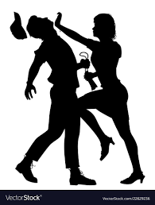
THE SEVEN PRINCIPALS OF SELF DEFENSE
By Colonel Jeff Cooper

Slide 2
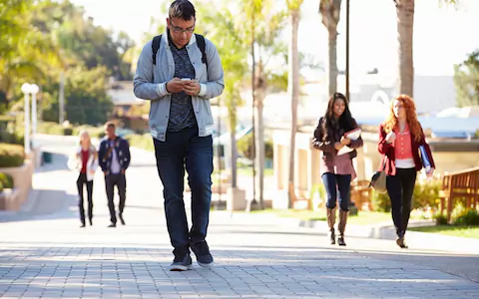
ALERTNESS
Be aware of your surroundings. Put away distractions.
Alertness is to some extent, an inherent personality trait, but it can be learned and improved (Ride along – Running Narrative).
Know what is behind you and what is out of place.
Once we accept that evil exists, we automatically sharpen our senses.
Make eye contact.
Always be ready to take appropriate action.
“A commander may be forgiven for being defeated, but never for being caught by surprise”

Slide 3
DECISIVENESS
It is difficult to change in an instant to take decisive action to meet with a violent emergency.
There is no time to ponder. The best course of action is to counter attack.
Contrary to civilized behavior but this principal can be cultivated with “What if” scenarios.
  Assists in recognizing threats and reacting quicker.

Slide 4
SURPRISE
First principal of offensive combat.
Most criminals expect their victims to cooperate.
They are looking for an easy target, expecting you to freeze, fall apart, and not know what to do.
Do what the assailant least expects us to do….
  A fast violent aggressive counterattack that will completely throw them off.

Slide 5
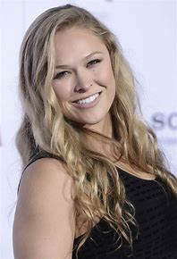
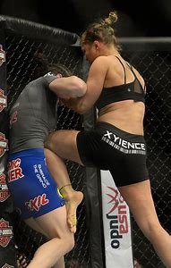
AGGRESSIVENESS
In defense we don’t initiate violence but our response to the attack should be overwhelming violence.
Aggressiveness provides an edge and the surprise factor since the assailant does not expect aggressiveness in victims.
Get angry, mean! Nobody may be around to help you.
Have a survivors/winning attitude.
Rhonda Rousey

Slide 6
SPEED
Speed is the essence of any form of combat.
The moment we recognize imminent danger we must move as fast as possible.
Practice, practice, practice!
Skills become second nature.

Slide 7
COOLNESS-CALMNESS
You must keep your head!
If you stay calm you will be able to perform under stress.
Take a deep breath, it is frightening.
Defuse the situation if possible.
“I will survive” attitude.

Slide 8
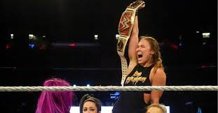
RUTHLESSNESS
Your assailant deserves no consideration.
Do not fight fair. Do whatever it takes to stop them.
Keep fighting until the threat has stopped.
“Messed with the wrong person today!”

Slide 9

QUESTIONS?

