Slide 1


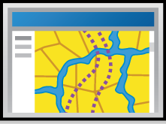



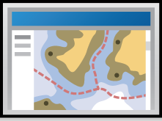
Incorporating GIS technology into local government
The Rancho Cucamonga Story
Presenters:
Ingrid Bruce – GIS/ Special District Manager
Solomon Nimako – Senior GIS Analyst
Web Applications
Tablets
Mobile
Field
Workers
Cloud
Office Workers
Citizen Apps

Slide 2
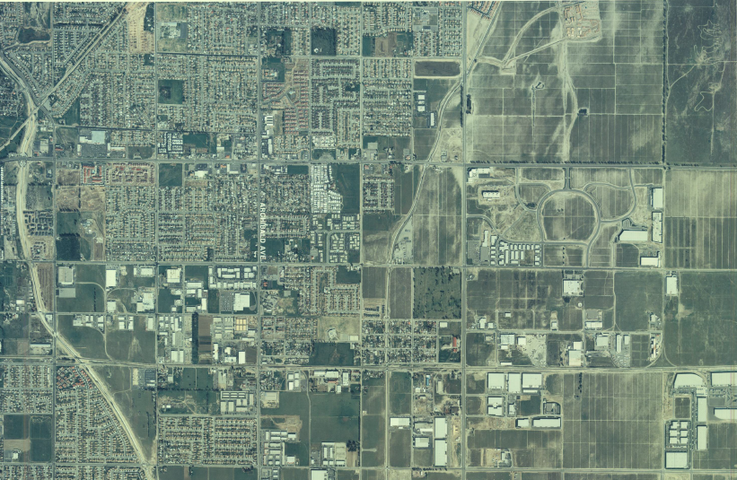
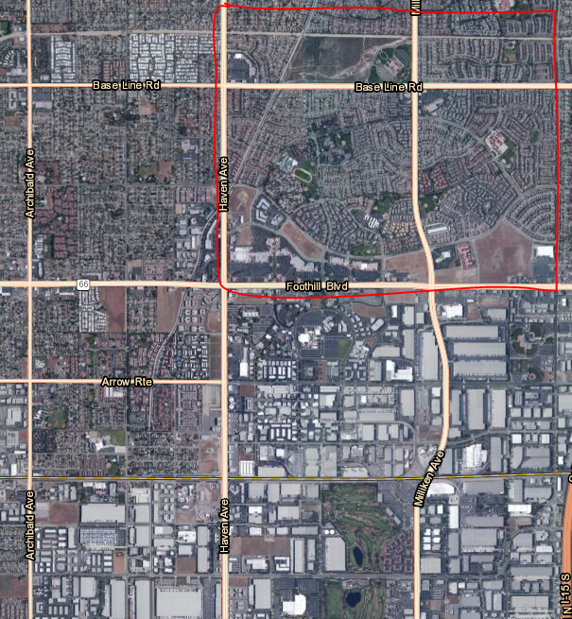
City Overview
1985
2014
Notes:
Here, we talk about how the city has developed over the years by comparing the maps

Slide 3
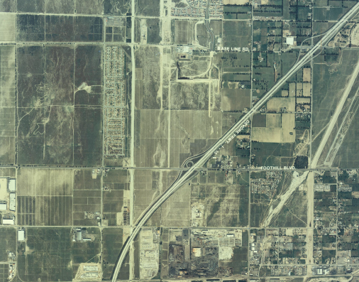
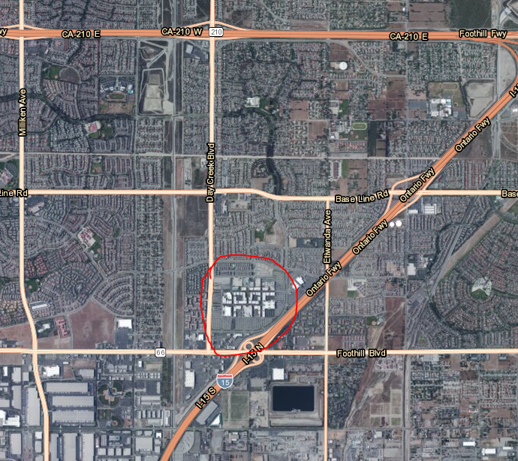
1985
2014
Notes:
In this example we compare another area of the city that most of the audience are familiar (VG mall) area. The point we stress here is that over the years the city has develop and with that come new challenges to city staff.

Slide 4
Service Delivery Model is Changing
Challenges:
  Coming out of the Great Recession, most agencies are still dealing with the impacts of a reduced workforce
  Increasing residential density and transit oriented developments
  Increased connectivity creates expectations of a faster response and response in different mediums than were used previously
  Increased Transparency Initiatives
    Constituents and Elected Officials are communicating more than ever through multiple social media real-time platforms
Approach
  Government needs to adapt new technologies to supplement traditional methods
    Increasing use of smart devices, tablets and other mobile devices
    GIS Cloud based systems complement this new mobility and connectivity
  Changing Technology helps streamline and improve work flow
    Work smarter NOT harder.
    Ex: sidewalk inspections using iPads; street lights & sign maintenance handled electronically also
Notes:
With the development growth and new age of technologies comes new service delivery request from residents. This means local governments have to change the traditional service models.

Slide 5
GIS Citywide Implementation
GIS
Library
Police
Animal Services
RC2GO
App
HealthyRC
IS
RC Exec.
Dashboard
GIS
Public Works
Engineering
Fire
Code
Enforcement
Building & Safety
Community
Services
Business
License
Notes:
Here start by briefly telling the audience when GIS was first bought by the city. The fact that we are ESRI customer # 61 and because the division was placed under the city manager’s office help shape the Rancho GIS. The list below talks about a few of the client we serve.
Fire: We support the fire department with daily response map books and block plans, perform various analyses including reflex time, travel time etc. Since RCFD took over the weed abatement program from the county of San Bernardino, we have worked with the fire department to develop a mobile application to assist with the weed abatement program.
Public Works: We are working on various projects with the department; sidewalk inspection, Street Light & Signs Inventory, Catch Basin and Storm Drain inspection, and street sweeper route maps.
Business License: identifying businesses and individuals without business licenses but filing taxes as a business. This is unique as we work with both the State Franchise Tax Board database and our business license database. We have developed an ArcGIS mobile interface for expired license inspection.
Code Enforcement and Building & Safety: We support them with map books, web application for locating parcel owner information, violation history etc
Community Service: Residence verification web application, periodic demography report generation.
Engineering: Field inspector mobile application, assets inventory
Library: Historic web application
Police: Assist with various mapping products including active shooter application, apartments & schools block plans.
Animal Services: Field map books for officers and vaccination & registration verification
HealthyRC: Assist with mapping various

Slide 6
Implementing an enterprise GIS
Build and develop relationships with clients (other department)
  This is key in succeeding
Create an identity for the GIS department
  Become a service oriented
  See other city departments are client
Promote an environment of creativity
Understand other departments workflows
Always use clear text when explaining GIS concepts to clients
Notes:
Here we share some learnings from years of implementing GIS.

Slide 7
Why add GIS to existing workflows?
Less expensive to maintain than mainframe programs
Greater ability to customize and tailor, even in-house
Quicker deployment than traditional software programs
Greater efficiency & effectiveness improves bottom line
Increased transparency & accountability for citizens
Notes:
We elaborate of the importance of implementing GIS. We switch and I run the audience through some of the application we have. We will keep it in-formal and Ingrid will jump.

Slide 8
Examples of In-House GIS App’s
GIS Portal
Citywide Sidewalk Inspection Program
RC Executive Dashboard
  Fire
  Police
  Public Works
Economic Development
RC2GO App
Notes:
Add some pictures

Slide 9
GIS Portal

Slide 10
Public Works GIS Deployment

Slide 11
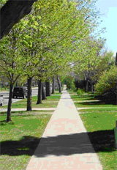
Sidewalk Inspection Program
Prior to GIS Mobile Application the process was:
  Walk each neighborhood
  Collect data on handwritten form
  Bring data back to office and input into system
  Exact locations often problematic; no pictures
  Long delay between recordation and correction
  Significant time required to complete entire city

Slide 12
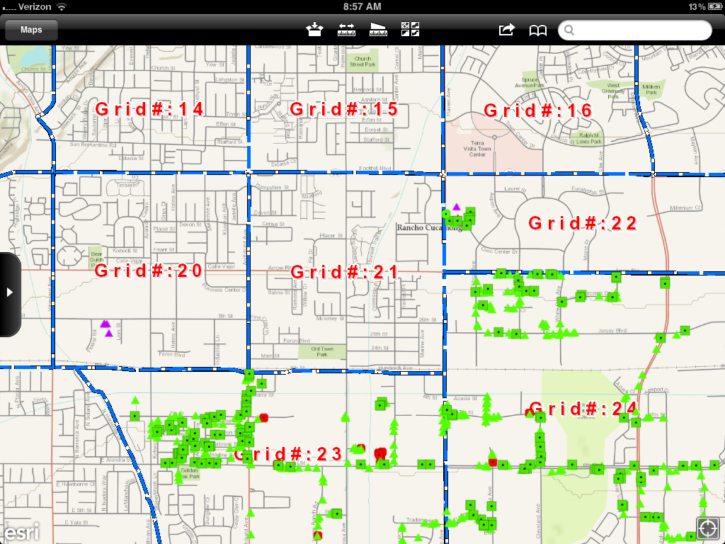
Sidewalk Inspection Program –
Post App Development
  Two year program
  Grid city into 24 zones
  Inspect/remedy 1 zone per month
  Complete entire city in 24 mos
  Document inspection / Document remedy information
  Sidewalk ramp or grind each trip hazard location

Slide 13
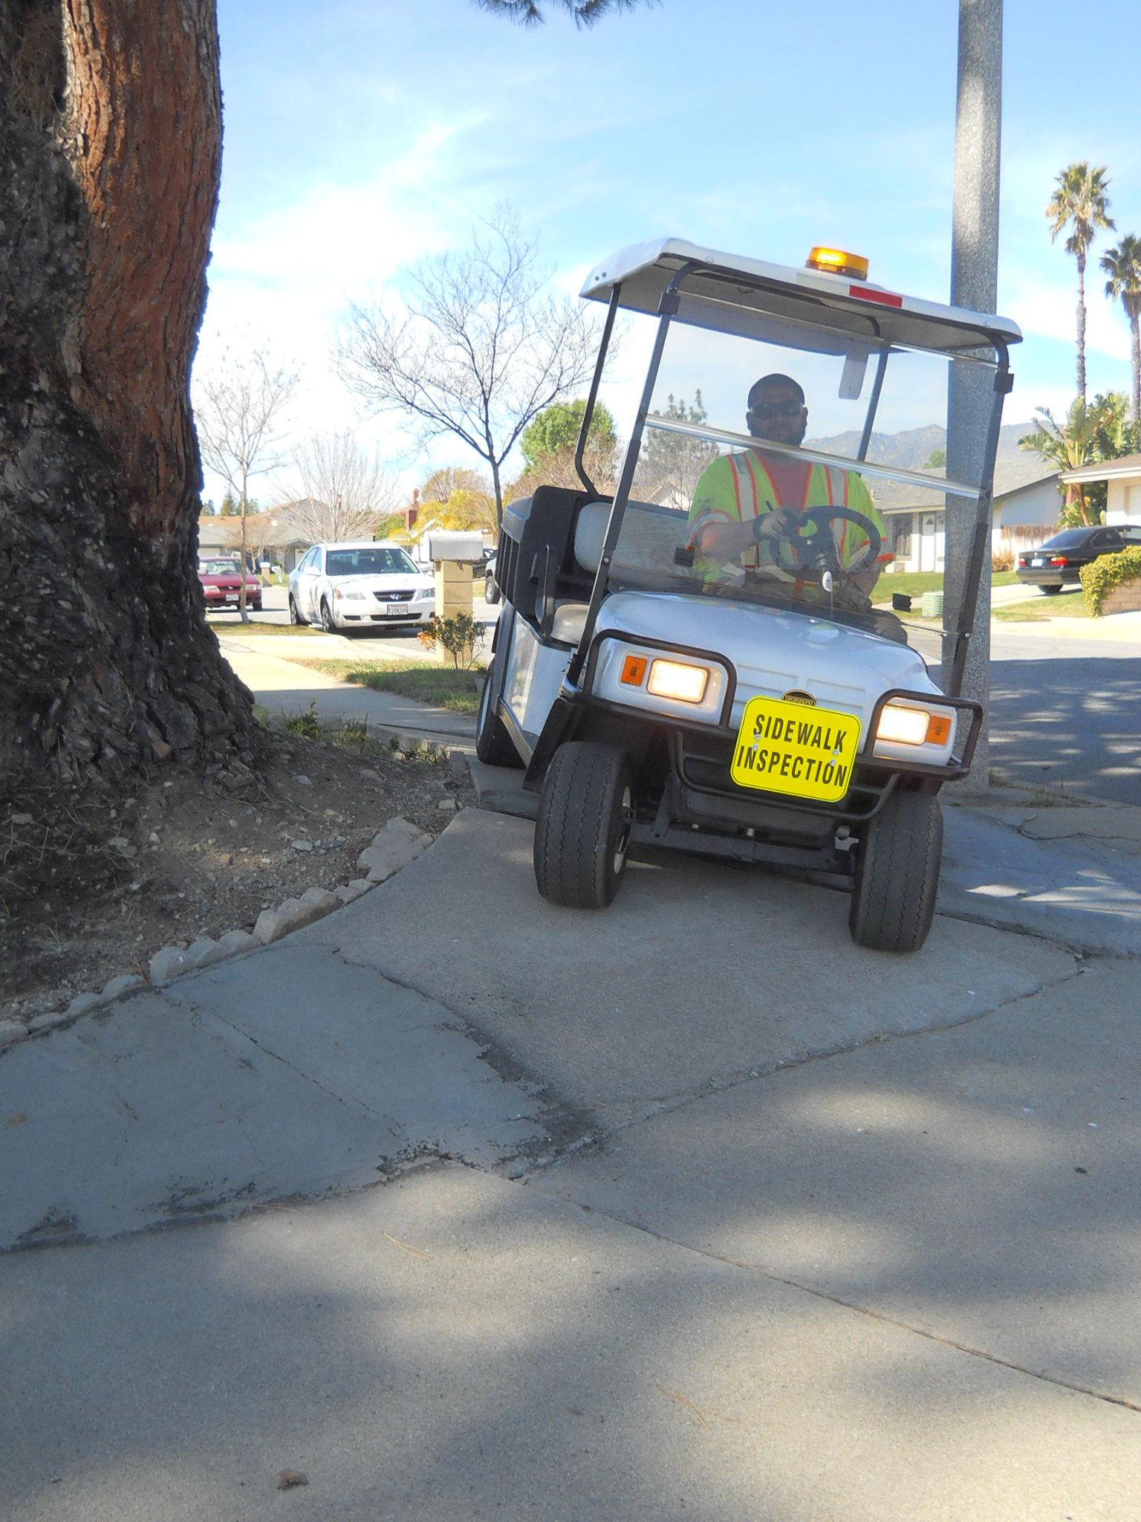
Sidewalk Inspection Program –
Post Mobile App Development
Using a City golf cart
Documenting using GIS App / Smart phone
No more manual inputting
  No paper required
  Real time information
Mobile App and golf cart provide for efficient inspections
Notes:
Using iPhones, iPad or any andriod devices, staff are able to do inspections and repairs in a more efficient manner. This approach also allows supervisors and field staff to see changes in real-time.

Slide 14
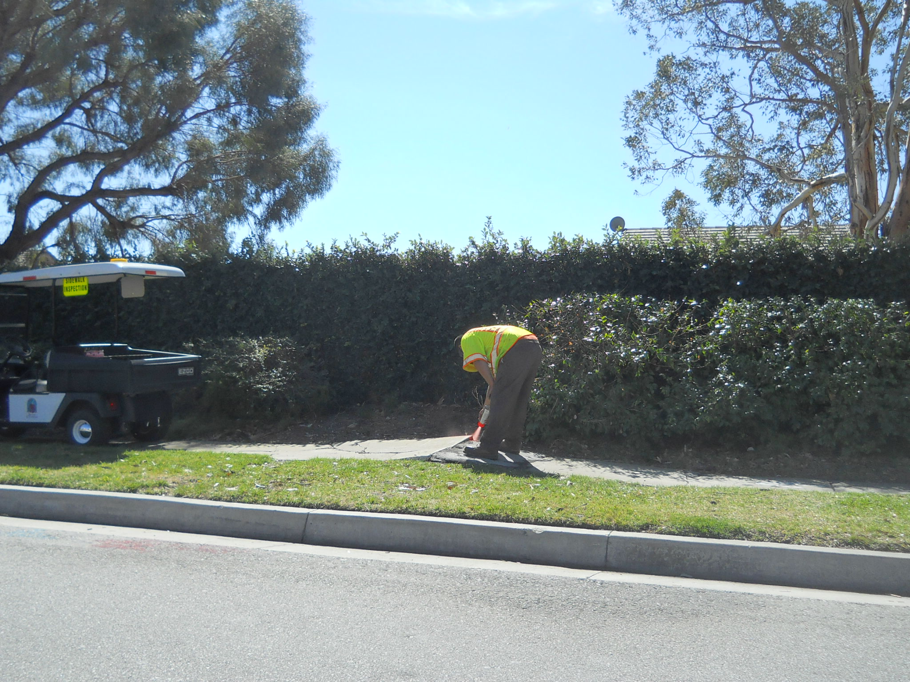
Areas of Importance
School zones
High pedestrian traffic areas
Senior centers
Interface with customer complaints
Share information with Engineering Department
Marking severe hazards with orange highlighted paint

Slide 15




System Design
Mobile
Smart Phones &
Tablets
Web Applications
Office
Workers
Field
Workers
Hybrid
ESRI ArcGIS Online Services
Desktops
REGIS Server with RC’s Content
GIS Staff
Produce Content and share on the web

Slide 16
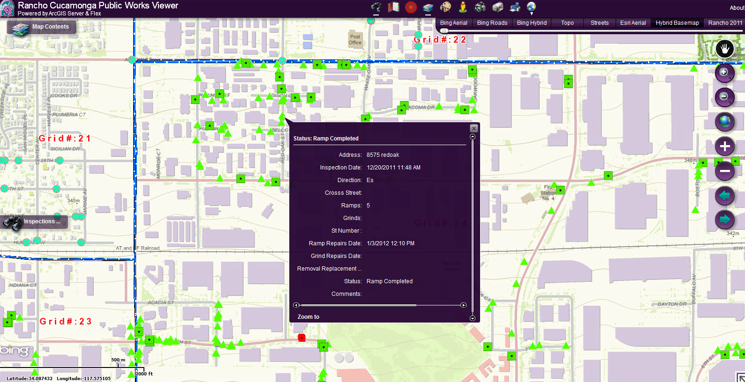
Interactive Web Application
Notes:
Field work done by field crew utilizing their smart phones are immediately seen by supervisors in the office. Any new incident created by office staff is also seen immediately by field crew.

Slide 17
Fire Department GIS Deployment

Slide 18
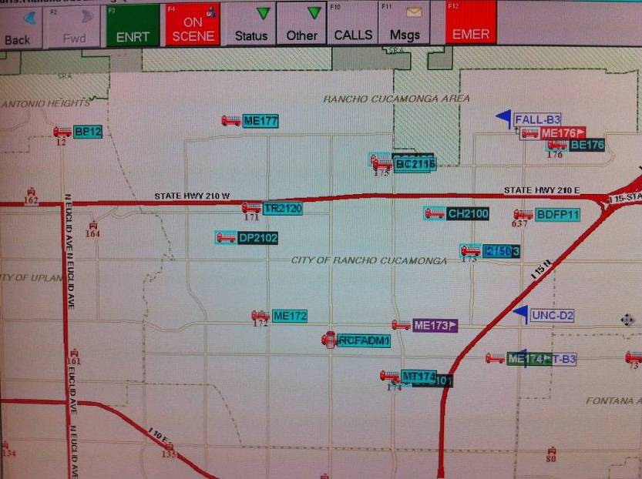
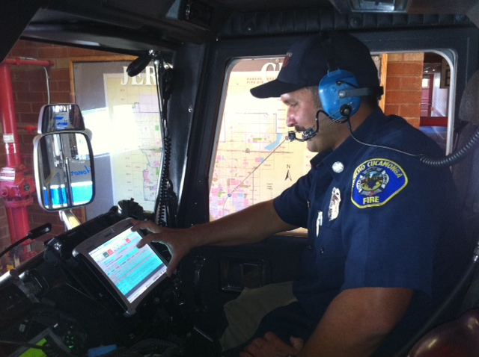
Daily Emergency Services
Utilizes “Automatic Vehicle Locator” Technology (AVL)
Computer Aided Dispatch System (CAD)
  Tracks real time unit location
Notes:
ConFire has loaded District block plans, hydrant and other important data into the CAD system. It routinely provides other relevant information to District units.

Slide 19
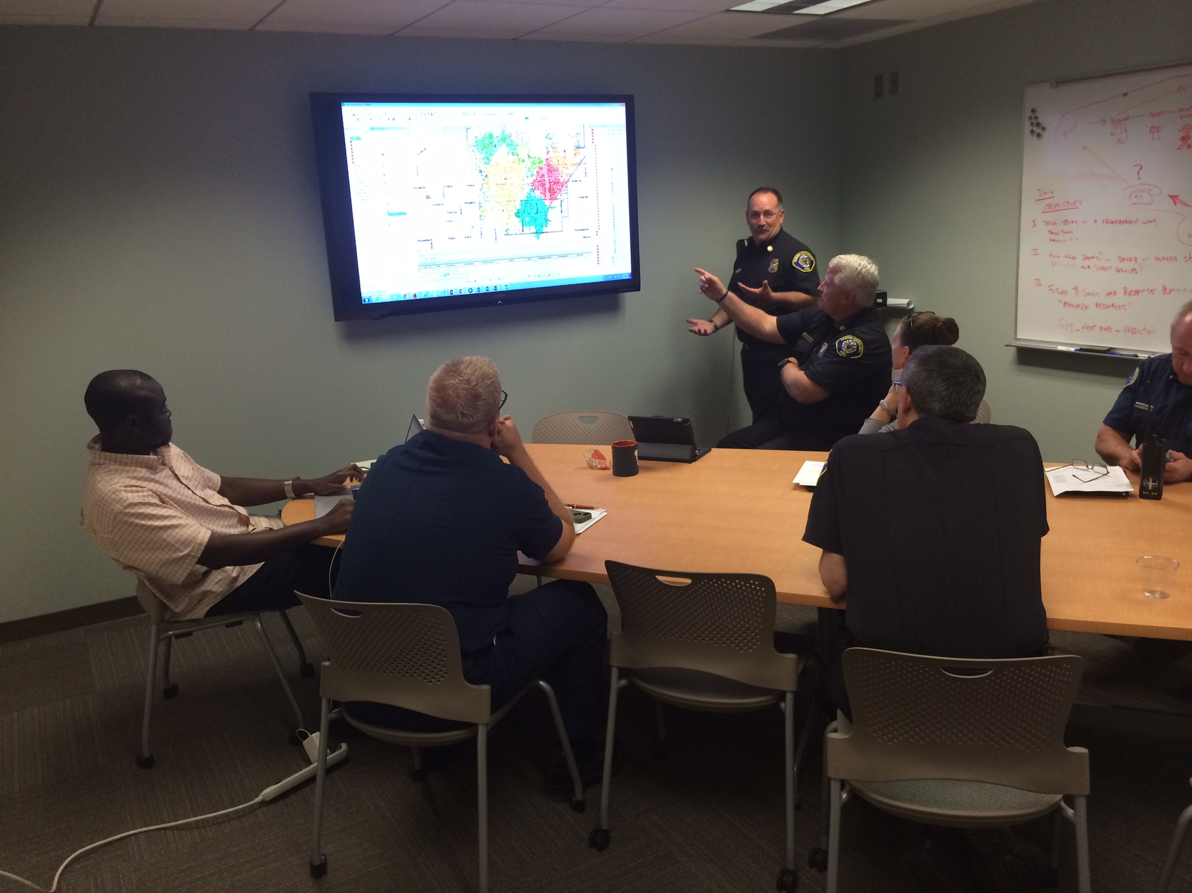
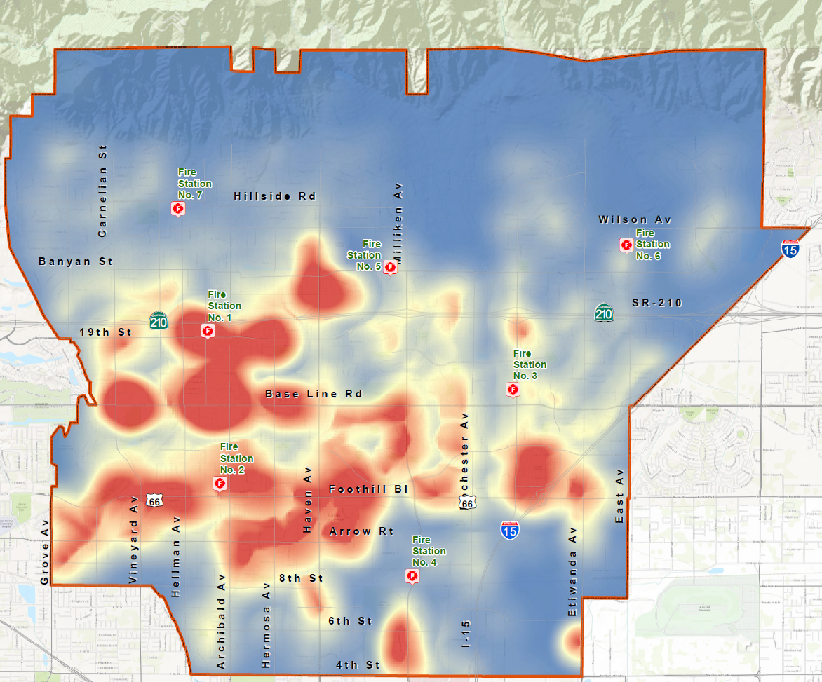
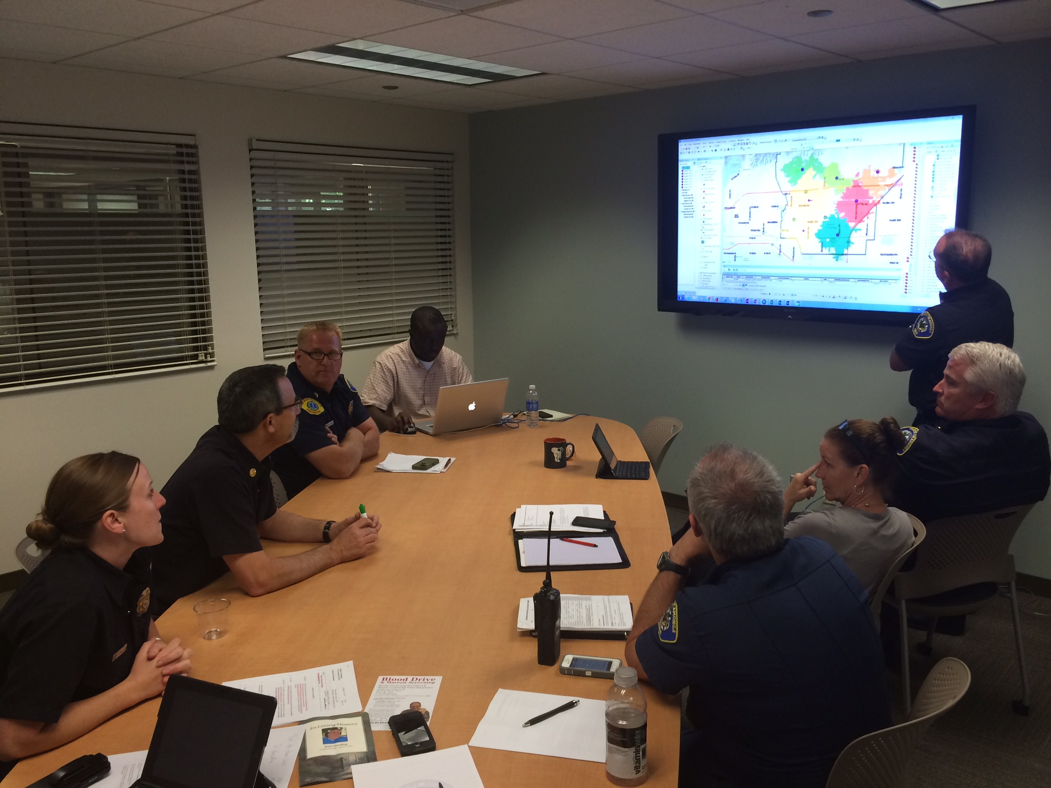
Data Analysis
Notes:
We talk about brainstorming session and Demo on iPad of the SOC layers

Slide 20
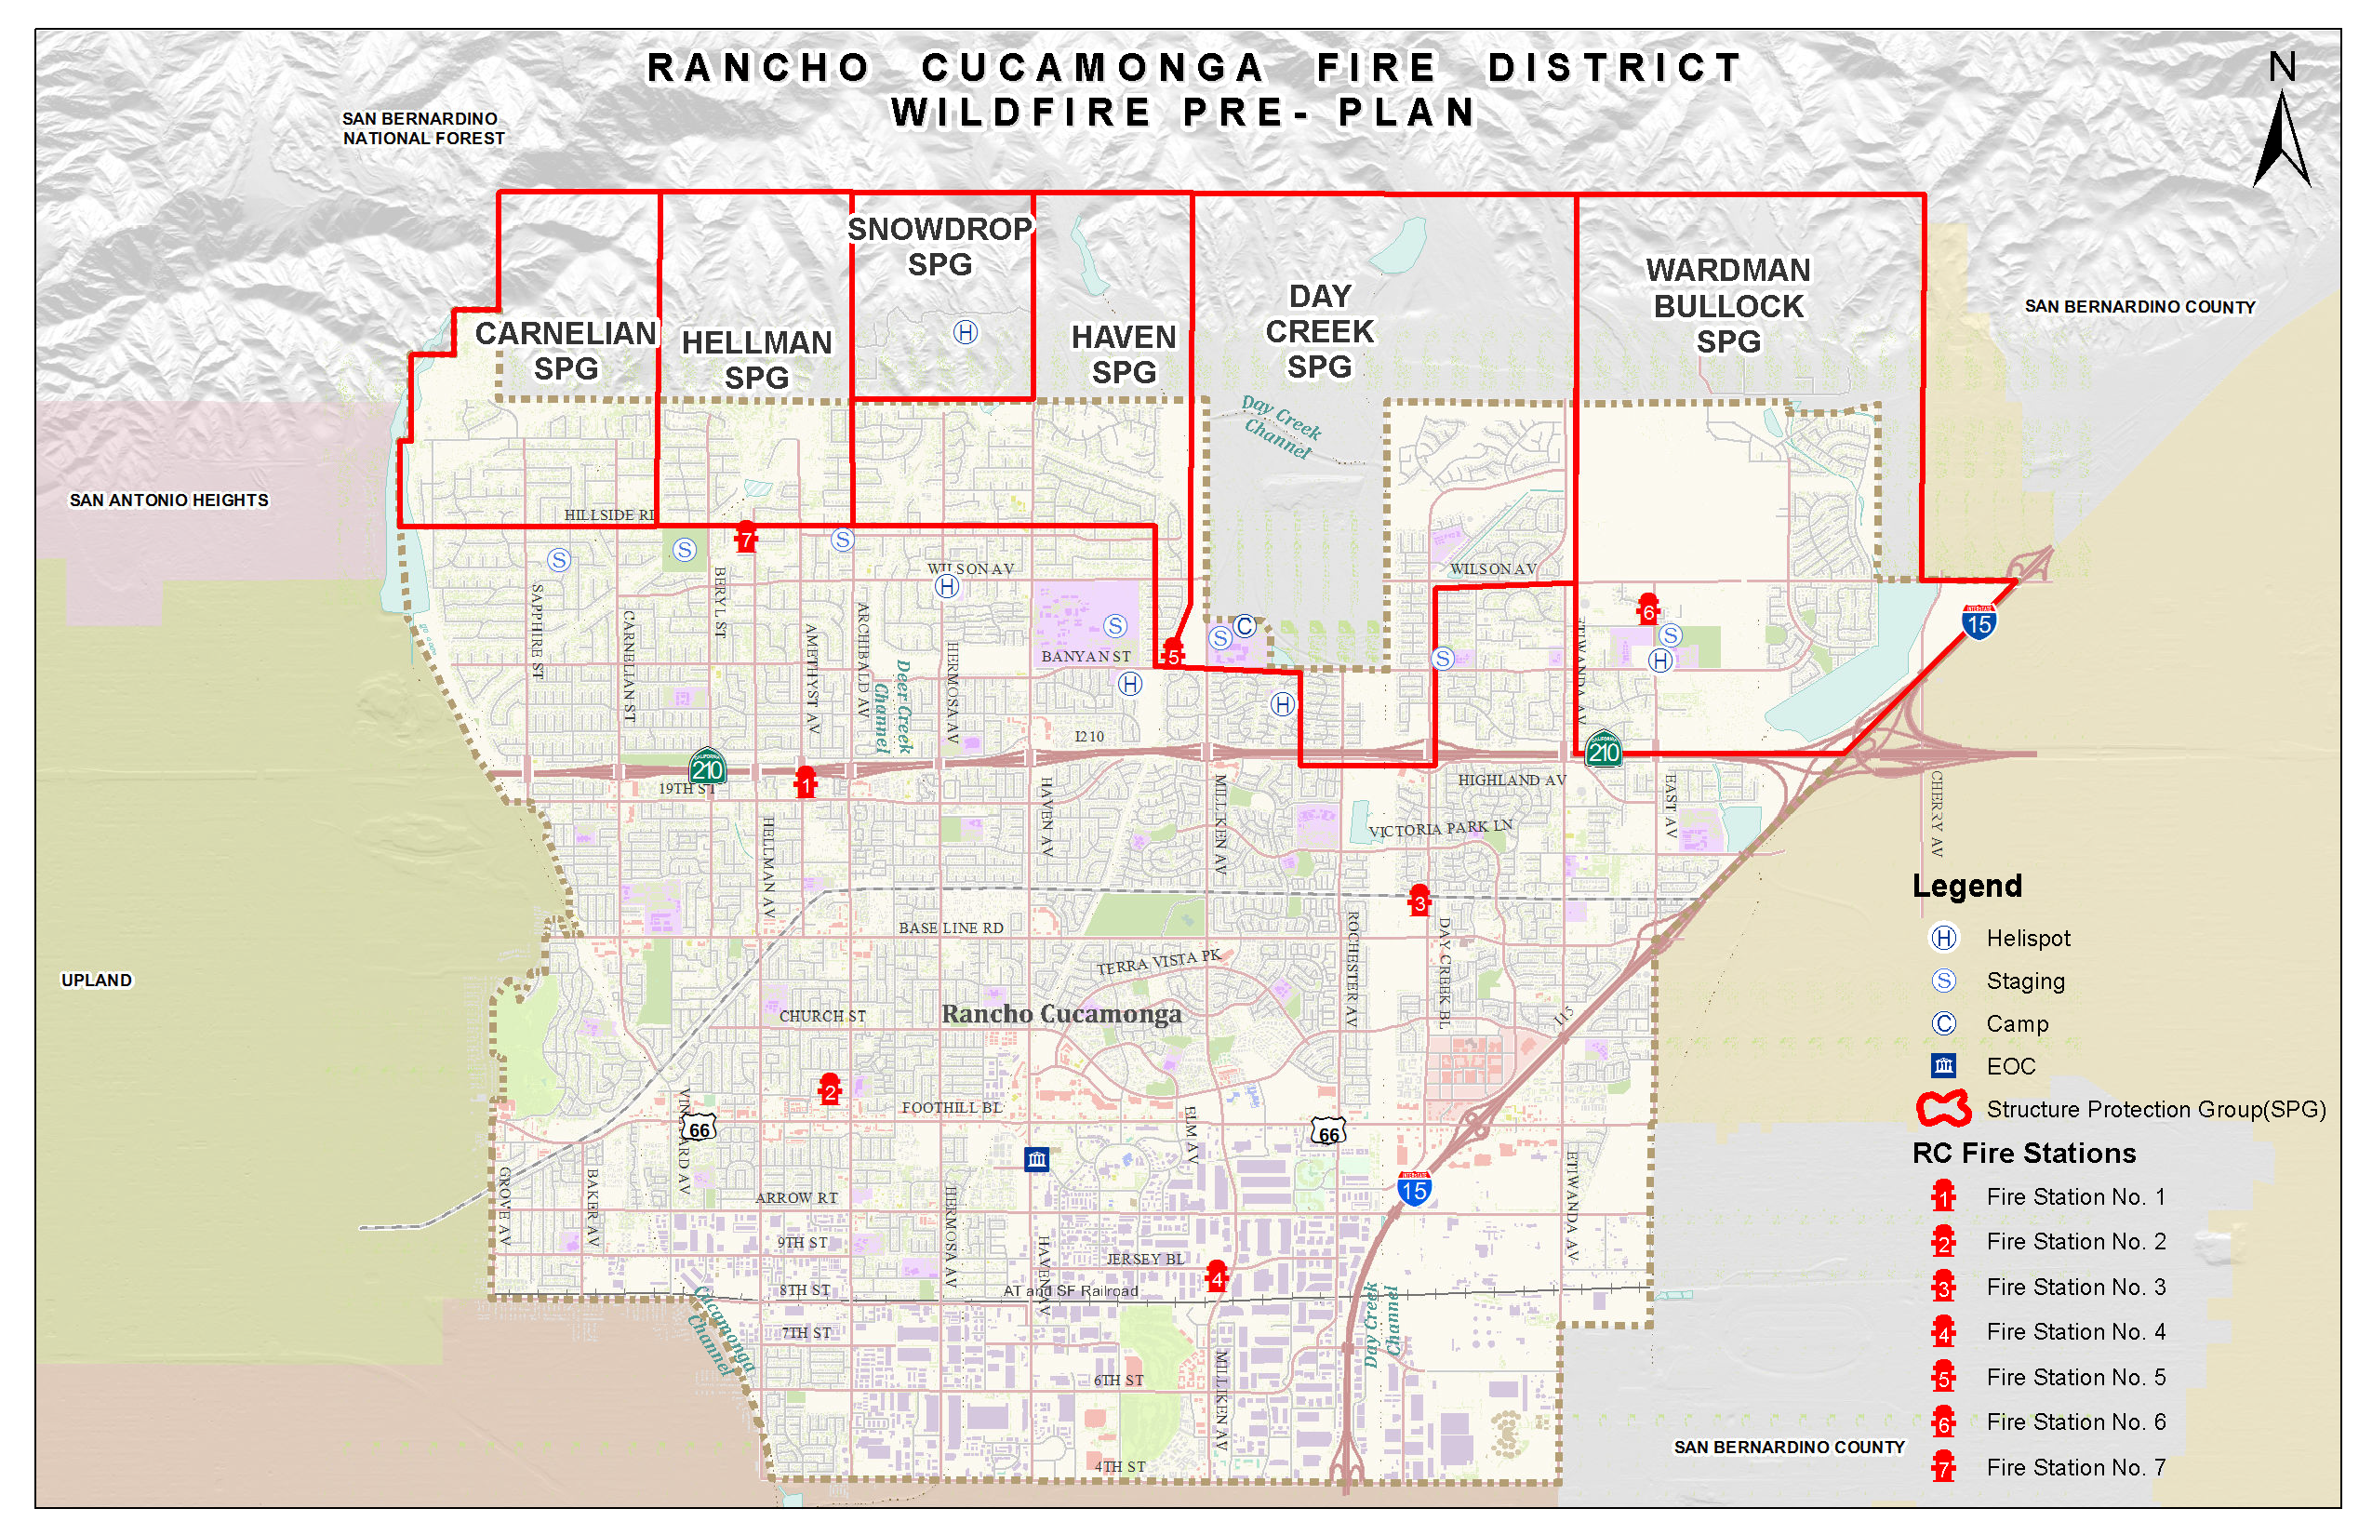
Structural Protection Group (SPG)

Slide 21
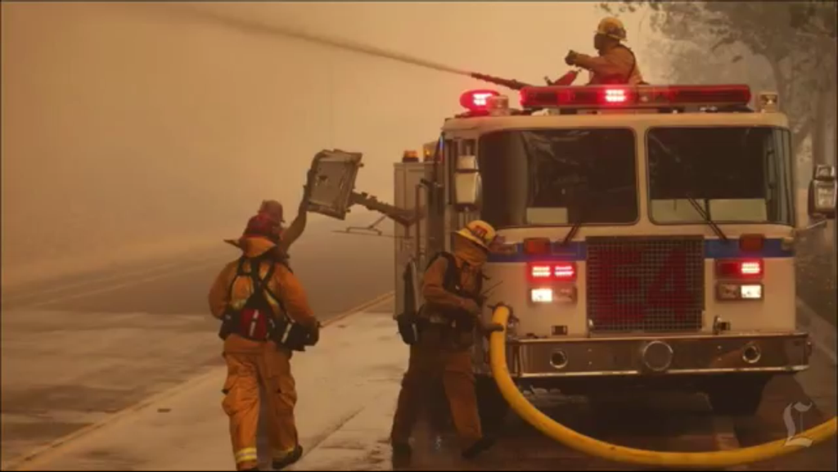
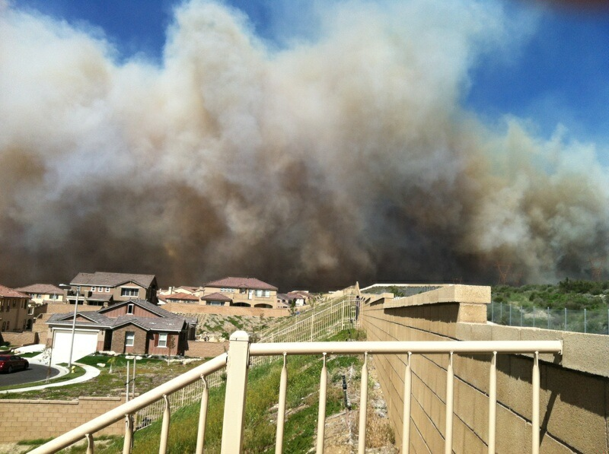
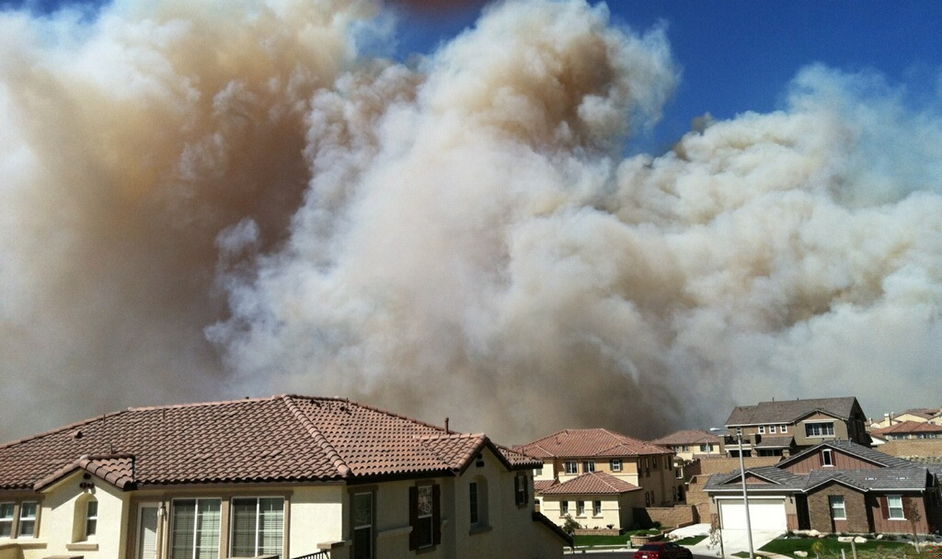

Etiwanda Fire

Slide 22
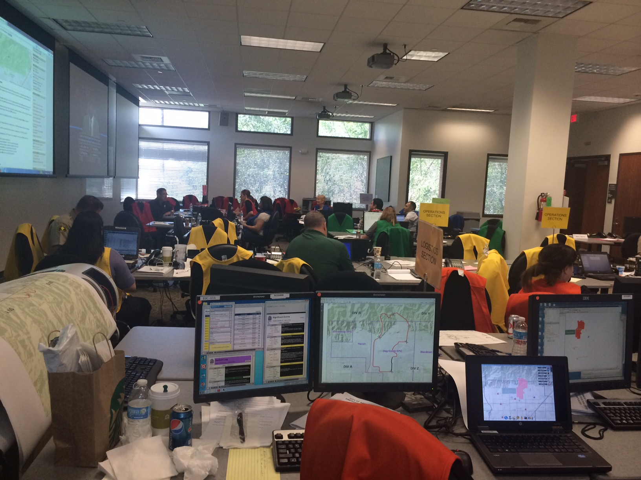
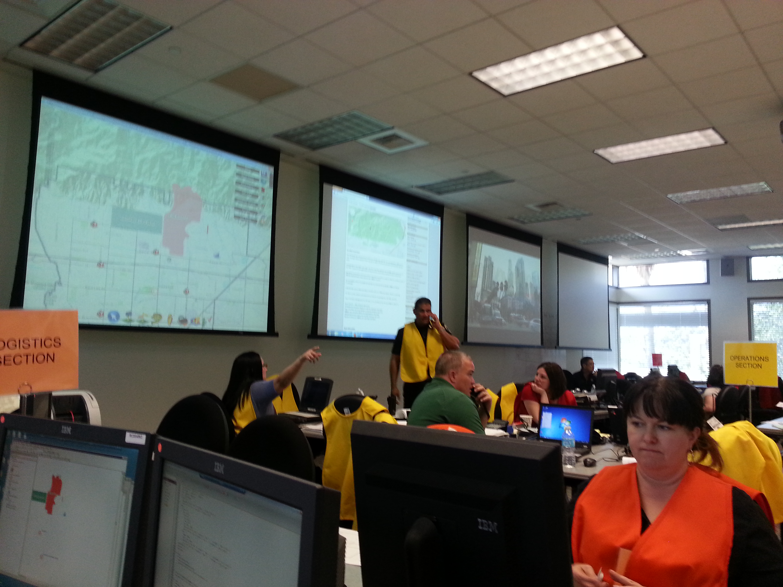
Emergency Operation Center (EOC)

Slide 23
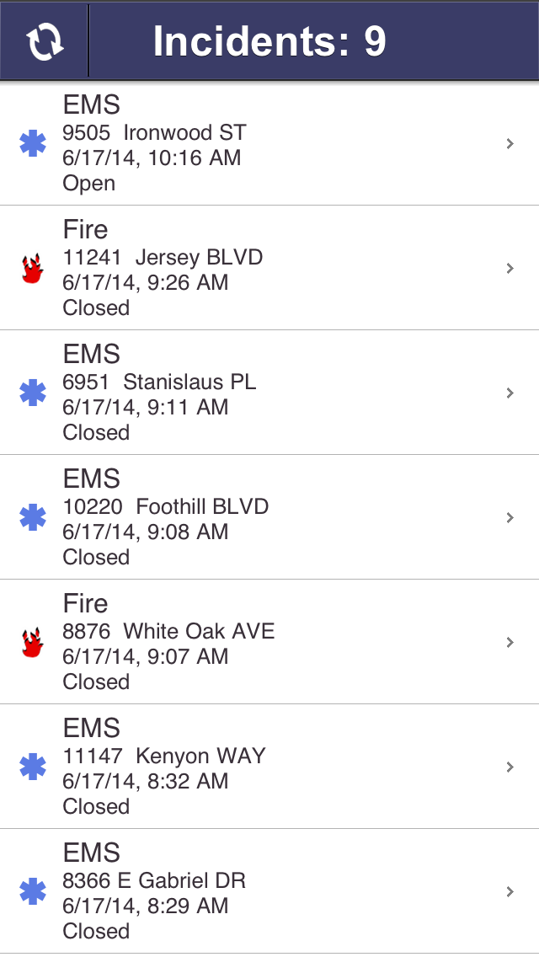
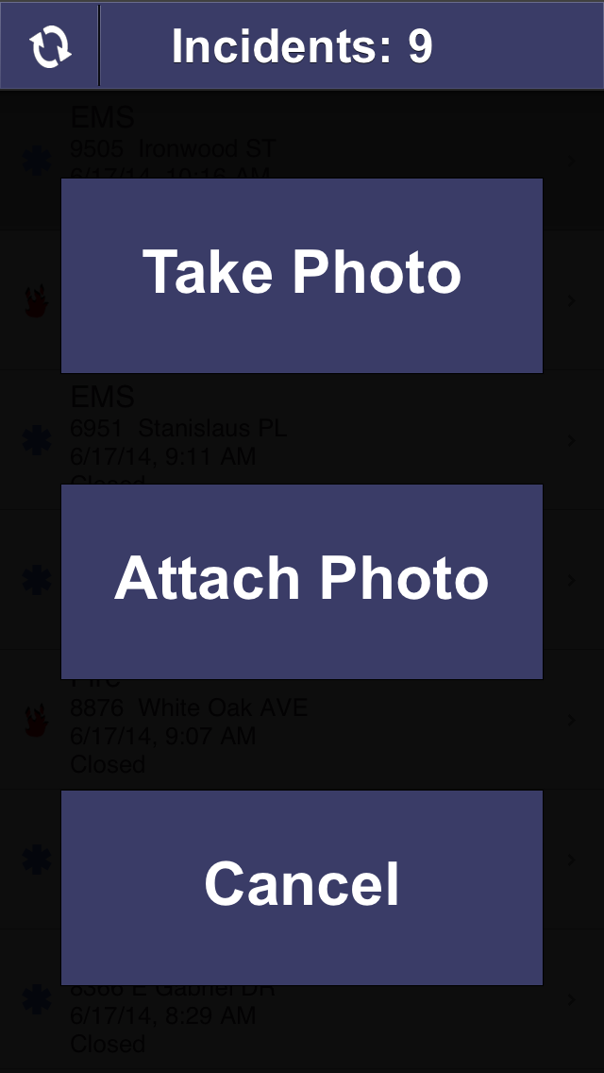
Quick shot App

Slide 24

RC Executive Dashboard App
Common Operational Picture:
  Know current responses by public safety team
    Fire
    Police
  Stay informed of incidents
    reports travel faster now with social media
  Stay one step ahead of the next phone from council members or residents
Dashboard app provides these answers for the executive team
Notes:
This is followed by app demonstration

Slide 25
Economic Development
Usually request hardcopy zoning or Parcel maps from GIS for:
  Potential development
  Business / Firm relocation
  Business meetings with investors
Challenges with static maps:
  Bulky
  Can display limited information
Using ESRI Mobile
  Access to dynamic web map
  Unlimited amount of data
  Pan & zoom
  Overlay layers
  Turn On/ Off layers

Slide 26
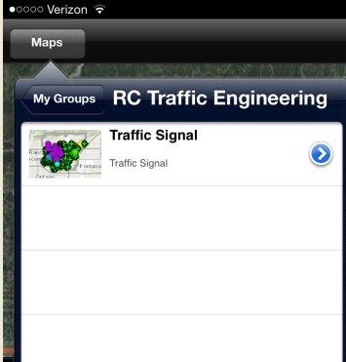

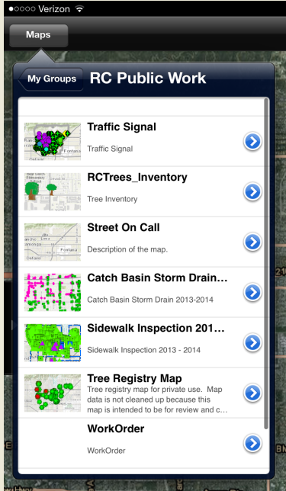
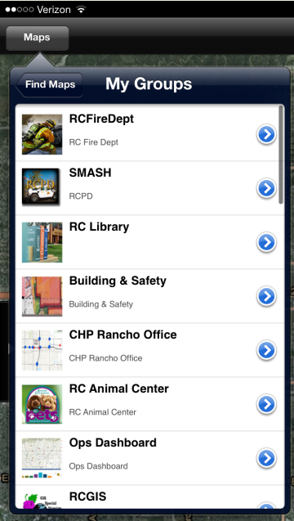
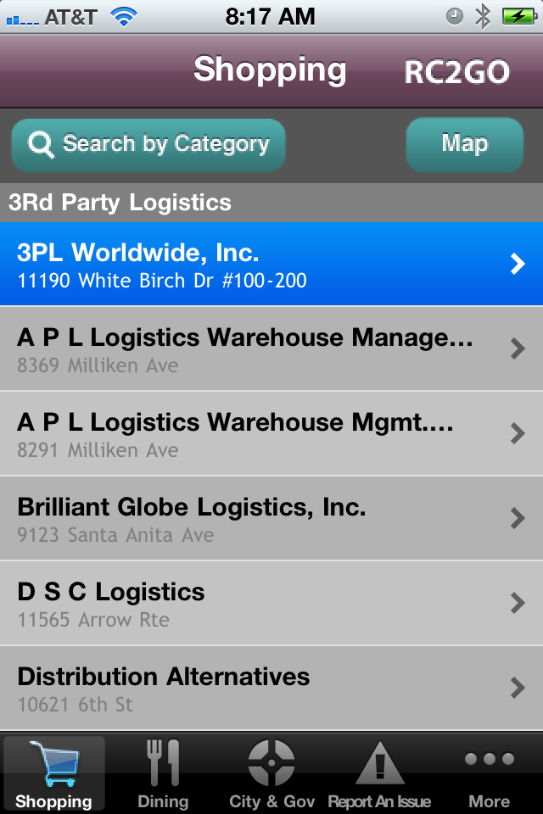
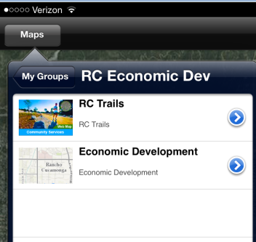
Other Mobile Deployments

Slide 27
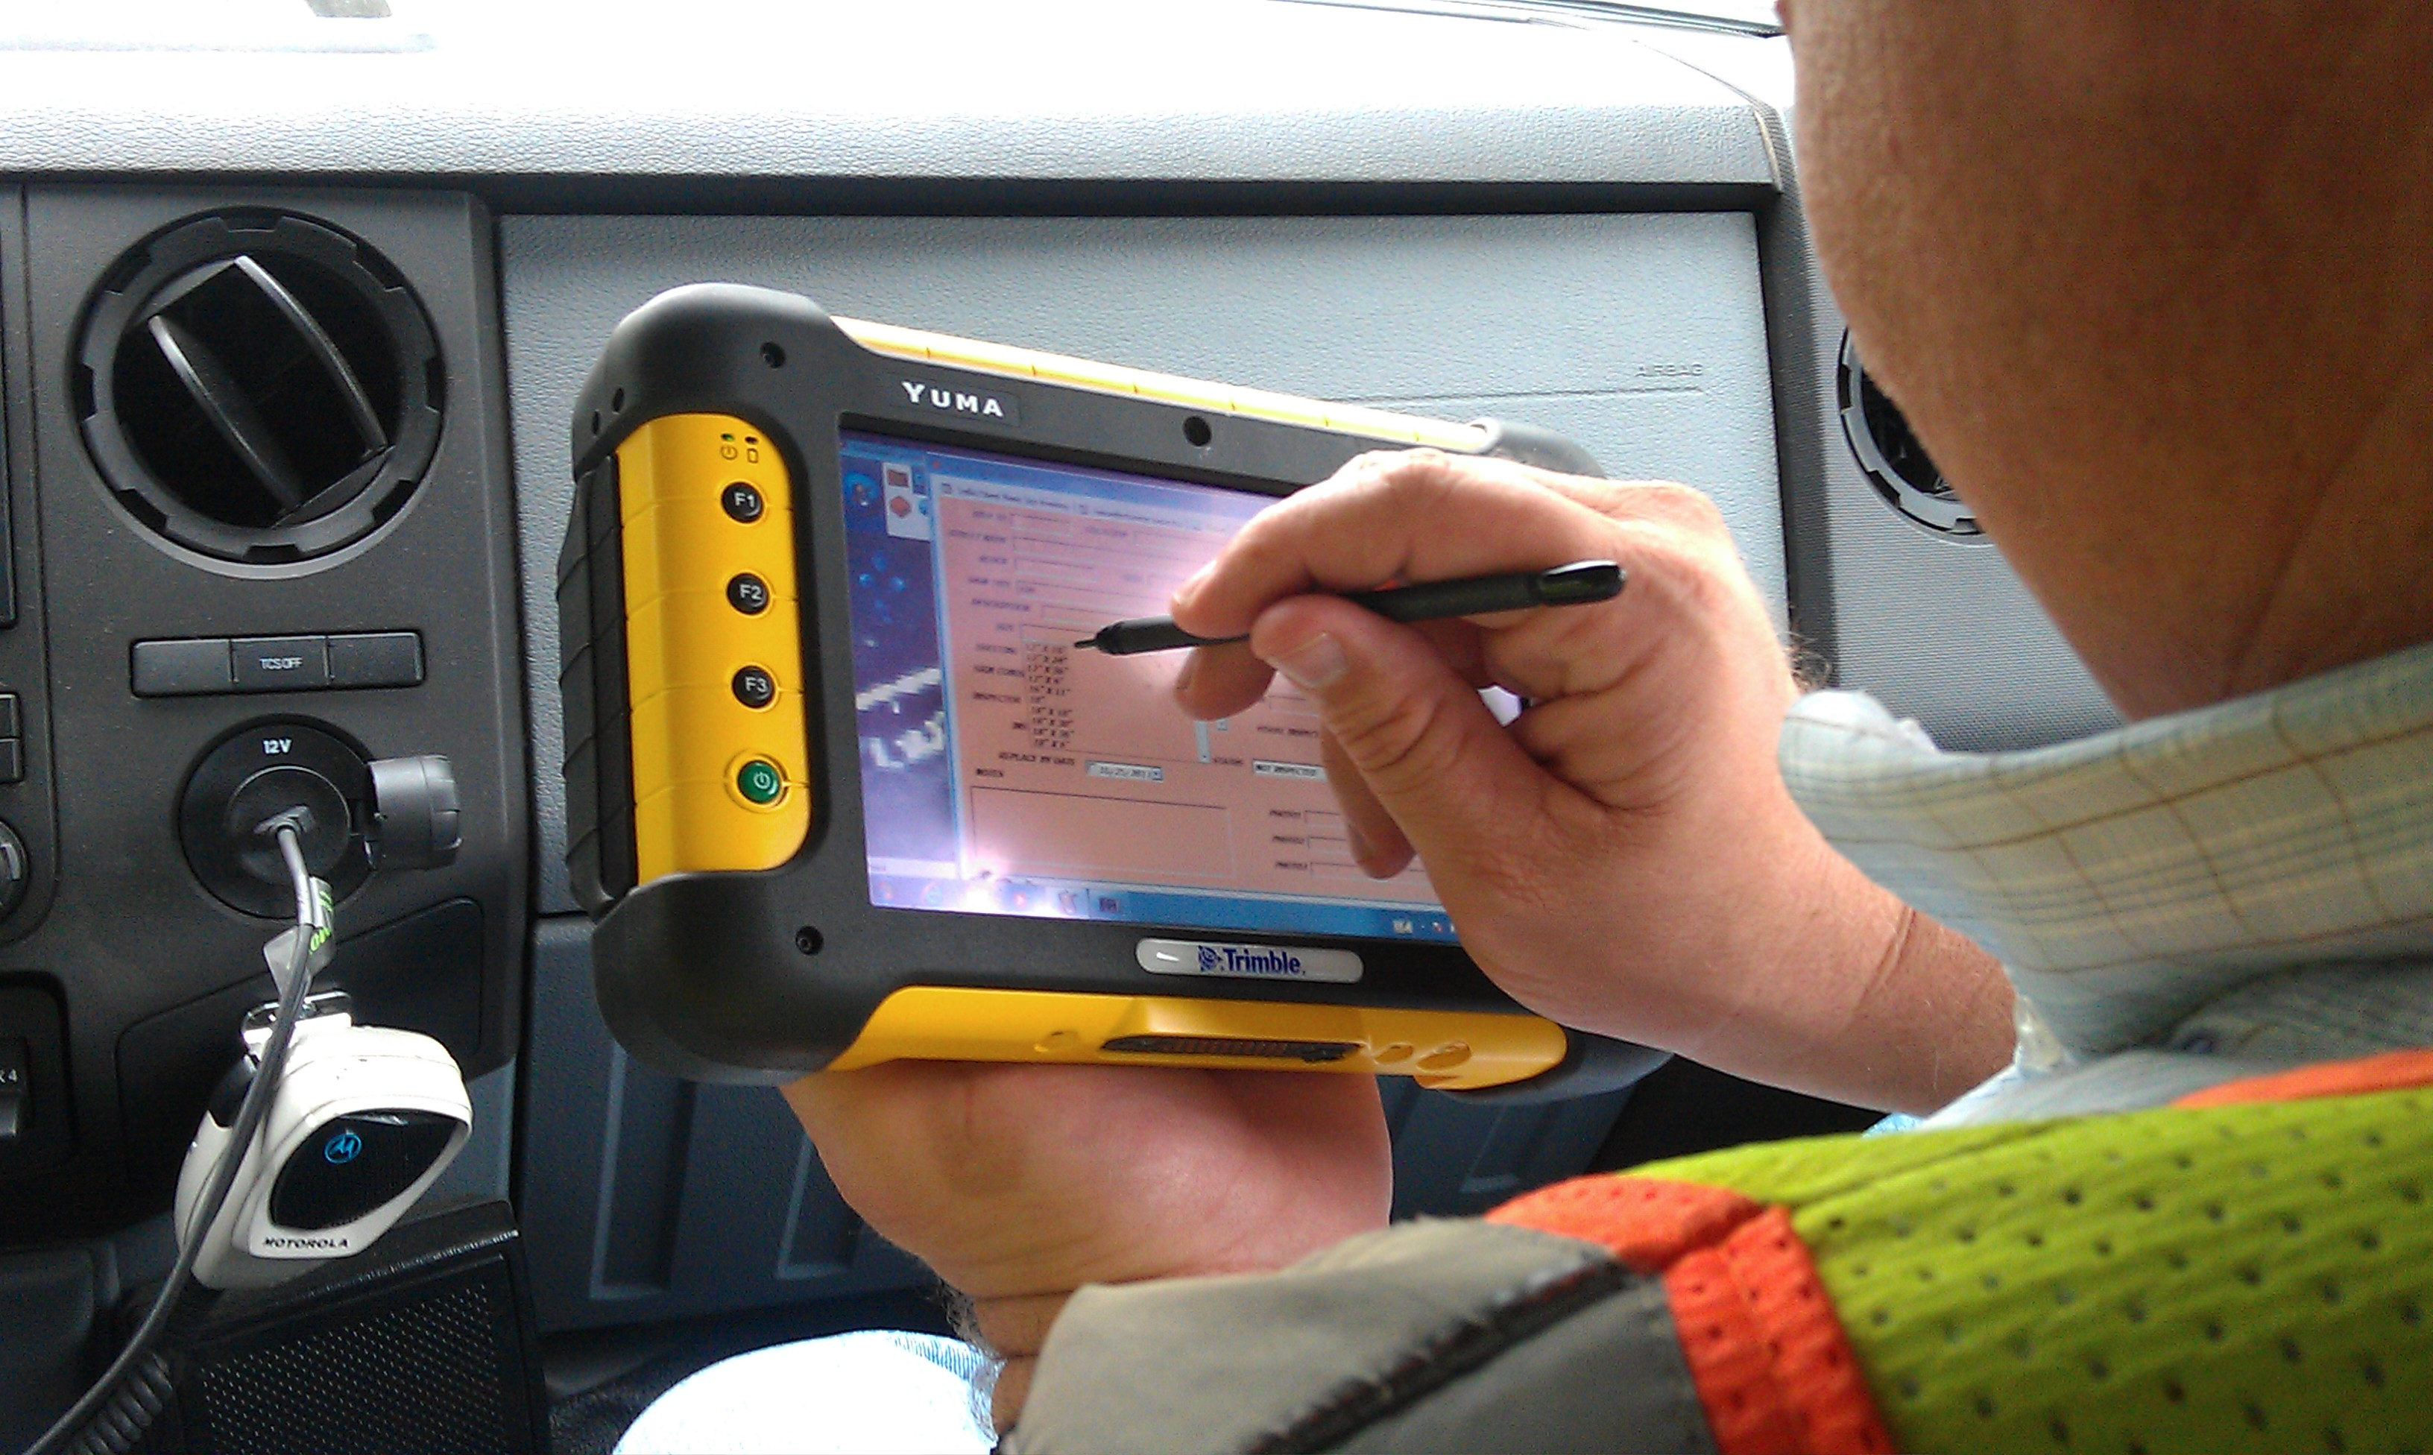
Conclusions
City decision makers have data in their hands when making critical decisions
Improved workflow and staff efficiency
City is more proactive in resolving issues
Improved data collection efficiencies and enhanced effectiveness
Initial up-front investment yields long-term results

