Slide 1
Research Opportunities in Location Analytics, Spatial Decision Making, and GIS for IS/IT Researchers:
Findings from An AIS-based Survey
Namchul Shin
Pace University
Pre-ICIS SIGGIS Workshop
Dublin, Ireland
December 11, 2016

Slide 2
Background: SIGGIS Workshop at AMCIS 2014
Observations about geospatial research in the IS/IT field (Pick and Shin, 2014)
  With explosion of location detection in billions of mobile devices, sensors, etc., geospatial research with IS/IT approaches becomes much more practically important.
  Increasing utilization of spatial and location-based applications during this decade by business, government, and consumers bodes well for its growing scholarly interest, but GIS is not well known in MIS research.
    Paucity of geospatial research in leading MIS journals, compared to other contemporary IS/IT topics, such as data mining, social networking, and group collaboration.
    More publications in the second level of IS/IT journals, in leading IS/IT conferences; some IS/IT-related articles have appeared in geographical journals.
  Corporate secrecy & limited training and educational emphasis.
  Paucity of conceptual theory that is attuned to both the IS/IT field and geography, space, and location.
  The early stage of GIS research in IS/IT and academic business literature offers great opportunity for MIS to play an important role; pave new pathways in an exciting and long-term future of 21st century IS/IT.
Notes:
Computer Science and Geographic Information Science are currently taking the lead
Transactions in GIS, International Journal of GIS, Applied Geography
Tobler’s first law of geography: “Everything is related to everything else, but near things are more related than distant things.”
Power of location: Location targeting improves the performance of mobile advertising, e.g., Foursquare.
Eco-routing rather than faster routing

Slide 3
2016 Spatial Analysis and GIS in Research Survey (SIGGIS)
Wide-ranging survey: gauge the use of GIS and spatial analysis in Schools/Colleges of Business, Management, and Information Science for research and scholarship.
36 questions, 6 – 20 minutes duration approx.
2014 and 2015 AMCIS & ICIS attendees (approx. 2,500 unique emails), AISWorld, INFORMS Digest, & 2016 pre-AMCIS SIGGIS workshop attendees (August 2016).
  A total of 160 responses
  124 complete and usable responses

Slide 4
Location Analytics & GIS Research:
Adopters vs. Non-Adopters
Does your research involve questions in which location is meaningful?
Research Question
To what extent does your research involve data in which location is a component (addresses, latitude/longitude, etc.)?
Data
To what extent do you examine the location component in your research for meaningful patterns and relationships?
Extent of examining location

Slide 5
Location Analytics & GIS Research: Adopters vs. Non-Adopters
No | Yes, but my major research questions have a weak connection to location. | Yes, my major research questions have a strong connection to location. | Yes, location is very important in my research.
1 | 2 | 3 | 4
Does your research involve questions in which location is meaningful?
To what extent does your research involve data in which location is a component (addresses, latitude/longitude, etc.)?
None of my research has a location component. | Some of my main research data has a location component. | A majority of my main research data has a location component. | All of my main research data has a location component.
1 | 2 | 3 | 4
Sum Score | Status | n | % Overall
3 | Non-Adopter | 20 | 16.13
4 - 8 | Beginner - Intermediate Adopter | 75 | 60.48
9 - 12 | Advanced Adopter | 29 | 23.39
To what extent do you examine the location component in your research for meaningful patterns and relationships?
None of the time | Somewhat | Majority of the time | All of the time
1 | 2 | 3 | 4
TOTAL |  | 124 | 100

Slide 6
What is the profile (age, gender, tenure, etc.) of typical adopters and non-adopters of GIS and location analytics research?

Slide 7
Demographic Profile of Respondents
Age | Overall | Non-adopters | Adopters – Intermediate | Adopters – advanced
Under 26 | 4 | 2 | 2 | 0
 | 3.23% | 10.00% | 2.67% | 0.00%
26 to 35 | 30 | 5 | 18 | 7
 | 24.19% | 25.00% | 24.00% | 24.14%
36 to 45 | 34 | 2 | 20 | 12
 | 27.42% | 10.00% | 26.67% | 41.38%
46 to 64 | 47 | 11 | 28 | 8
 | 37.90% | 55.00% | 37.33% | 27.59%
65 or older | 9 | 0 | 7 | 2
 | 7.26% | 0.00% | 9.33% | 6.90%
Sample size | 124 | 20 | 75 | 29
Country | Overall | Non-adopters | Adopters – Intermediate | Adopters – advanced
USA | 68 | 13 | 36 | 19
 | 54.84% | 65.00% | 48.00% | 65.52%
Others | 56 | 7 | 39 | 10
 | 45.16% | 35.00% | 52.00% | 34.48%
Sample size | 124 | 20 | 75 | 29
Gender | Overall | Non-adopters | Adopters – Intermediate | Adopters – advanced
Male | 86 | 11 | 53 | 22
 | 69.35% | 55.00% | 70.67% | 75.86%
Female | 34 | 7 | 21 | 6
 | 27.42% | 35.00% | 28.00% | 20.69%
Do not want to disclose | 4 | 2 | 1 | 1
Sample size | 124 | 20 | 75 | 29
Geography
  Intermediate adopters split evenly in US vs ROW.
  Advanced adopters: US vs ROW is about 2:1.
Age
  Intermediate level adoption increases with age and peaks in the 46-64 category.
  Advanced adoption peaks in the 36–45 category.
Gender
  More adoption by men.

Slide 8
What are some types of locational research that are (or may be) relevant to researchers?

Slide 9
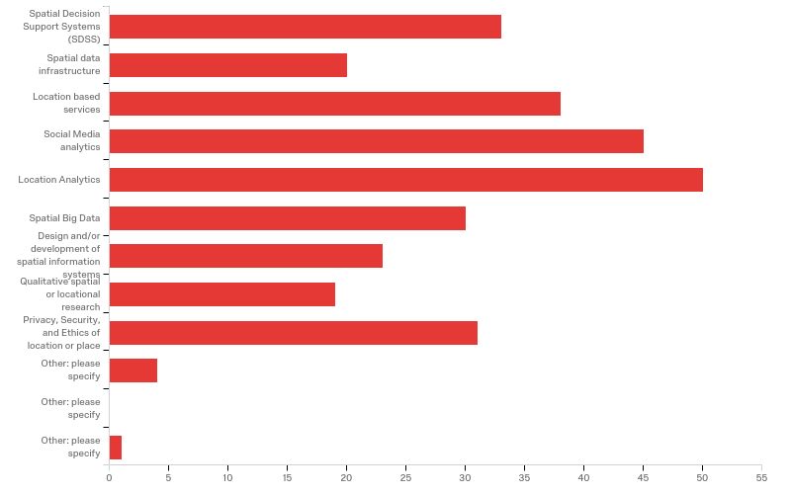
Types of Locational Research
34.74%
21.05%
40.00%
47.37%
52.63%
31.58%
24.21%
20.00%
32.63%
5.26%
Total Respondents: 95 (Select all that apply)

Slide 10
Other Types of Locational Research
Other: please specify
Virtual and Spatial Distances
Spatial Workflow and Algorithm Design
Spatial Algorithm Design
Location as Controls or Data Slices

Slide 11
What are some social and/or behavioral aspects of spatial research that are (or may be) relevant to researchers?
What are some of the spatial theories that researchers are familiar with?

Slide 12
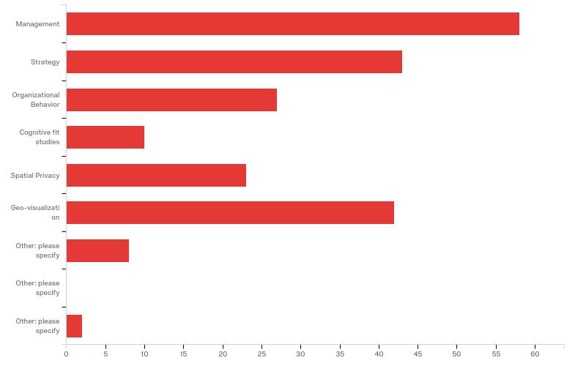
Social/Behavioral Aspect of Spatial Research
59.79%
44.33%
27.84%
10.31%
23.71%
43.30%
10.31%
Sample Size: 97 (Select all that apply)

Slide 13
Other Social/Behavioral Aspects of Spatial Research
Other: please specify
Crime Research
Network structures
Economic Geography
Security
Consumer behaviour
Climate change impacts
none
regulatory setting

Slide 14
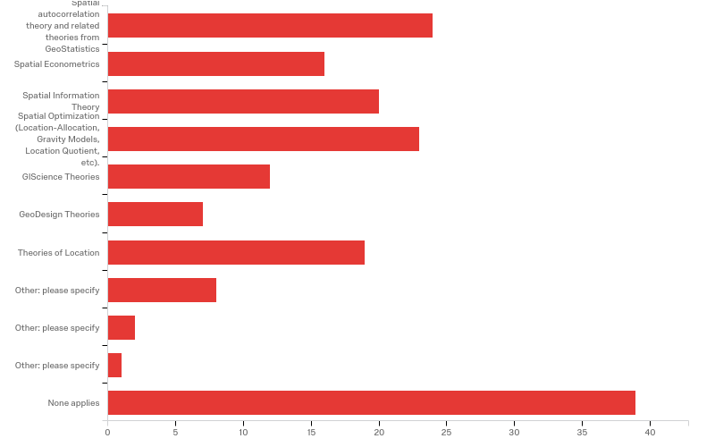
Familiarity with Spatial Theories
24.74%
16.49%
20.62%
23.71%
12.37%
7.22%
19.59%
11.34%
Sample Size: 97 (Select all that apply)
40.21%

Slide 15
Familiarity with Spatial Theories
Other: please specify
Network and Diffusion Theories
Accounting Theories
Cluster and Agglomeration Theories e.g. Porter's Diamond Model
Social Geography
Location as Controls or Data Slices
Spatial Diffusion
Markov Random Fields

Slide 16
Key Takeaways
Most relevant research areas
  Location and social media analytics, location-based services, SDSS, spatial big data, as well as privacy, security, and ethics of location or place
Relevant social/behavioral aspects of spatial research areas
  Management, strategy, and geo-visualization
  Other research areas may be crime research, economic geography, consumer behavior, etc.
Familiarity with spatial theories:
  Commonly known theories:
    Spatial autocorrelation & related theories from geo-statistics
    Spatial optimization theory
  A larger proportion of advanced adopters indicate familiarity with particular spatial theories such as spatial autocorrelation and spatial econometrics compared to intermediate adopters (findings from an earlier survey).
    Possibly explains their advanced status!!
Notes:
There are lots of questions to be answered and much future work to be done, for example, business models of location-based mobile promotion or location-based services for different stakeholders (other than consumers), and post-adoption (or continued use) of location-based services.

Slide 17
What are some inhibitors and enablers of adoption of GIS and location analytics?
Are there differences between adopters and non-adopters?

Slide 18
Geographic information systems (GIS) in the coursework by your own Department/School/College?
Graduate Coursework Offered | Advanced Adopter | Intermediate Adopter | Overall
No | 7 (21.21%) | 34 (57.63%) | 41 (44.57%)
Yes, as a core course | 11 (33.33%) | 2 (3.39%) | 13 (14.13%)
Yes, as an elective course | 8 (24.24%) | 13 (22.03%) | 21 (22.83%)
Yes, but not in my home department/Schools | 7 (21.21%) | 10 (16.95%) | 17 (18.48%)
Sample Size | 33 | 59 | 92

Slide 19
Extent to which leading journals in your area of research are receptive to publishing spatial/ location-based research
Extent to which leading journals are receptive towards spatial/location-based research | Overall | Adopters – Intermediate | Adopters – advanced
1 (Not receptive at all) | 2 | 2 | 0
2 | 15 | 12 | 3
3 | 12 | 10 | 2
4 (Moderately Receptive) | 43 | 32 | 11
5 | 15 | 8 | 7
6 | 5 | 2 | 3
7 (Highly Receptive) | 3 | 1 | 2
Sample size | 95 | 67 | 28
Average | 3.85 | 3.67 | 4.39

Slide 20
Reasons for little or no use of spatial analysis in research
Reason for not doing spatial analysis in research | Overall | Non-adopters
My research questions are non-spatial (i.e., they do not have a location component). | 18 | 18
I have yet to figure out the spatial dimensions of my research. | 3 | 3
I am unfamiliar with spatial analysis theories and methods. | 6 | 6
I am familiar with spatial analysis theories and methods but unfamiliar with the technologies. | 0 | 0
I have included spatial analysis in prior research with little or no benefit. | 0 | 0
Spatial analysis has no impact on the actual publication possibility in my area of work. | 3 | 3
I do not sense spatial analysis adds any beneficial insights in my area of research at the present time. | 9 | 9
Not applicable | 0 | 0
Sample size: 20 (respondents choose all that apply) | 39 | 39
Notes:
Initial results seem to indicate that the leading barrier of location analytics research is:
Perception of inadequate graduate education and low-moderate reception of spatial analysis in research by leading journals in their area of research
Other barriers for location analytics research are perceived value, unfamiliarity with theories, and possibly unfamiliarity with spatial dimensions of own research.

Slide 21
Potential for GIS and spatial analysis to benefit research and scholarship
Potential for GIS and spatial analysis to be beneficial to your research and scholarship | Overall | Non-adopters | Adopters – Intermediate | Adopters – advanced
Yes | 79 | 3 | 48 | 28
 | 68.70% | 15.00% | 71.64% | 100.00%
No | 17 | 11 | 6 | 0
 | 14.78% | 55.00% | 8.96% | 0.00%
Yes, in the future but not at the present time | 19 | 6 | 13 | 0
 | 16.52% | 30.00% | 19.40% | 0.00%
Sample size | 115 | 20 | 67 | 28

Slide 22
Ability and knowledge of students for spatial analysis and GIS to be beneficial for professional careers
Students’ ability and knowledge of spatial analysis and GIS to be beneficial for professional careers | Overall | Non-adopters | Adopters – Intermediate | Adopters – advanced
Yes | 77 | 8 | 44 | 25
 | 80.21% | 53.33% | 78.57% | 100.00%
No | 19 | 7 | 12 | 0
 | 19.79% | 46.67% | 21.43% | 0.00%
Sample size | 96 | 15 | 56 | 25

Slide 23
How do you suggest broader and deeper use of GIS and spatial analysis might be achieved in your discipline?
A high-quality, business-focused GIS/spatial analytics journal
Comprehensive graduate and undergraduate-level courses—introducing GIS early in undergraduate courses
  The big issue is faculty. They don't know how important this is.
In conjunction not only with BI and Big Data, but also with fundamental concepts in the IS field
Research questions that include location
Multidisciplinary: IT, geography (location) and others, such as economics, agriculture
  Data, tools (analytics), and problem domains in combination for both teaching and research
  Applying advanced analytics techniques, e.g., spatial econometrics, geo-data visualization
Free access to GIS software and support from vendors of GIS software; use of R (easy to customize than ArcGIS)
Short workshops, webinars, tutorials
A stronger focus on solutions

Slide 24
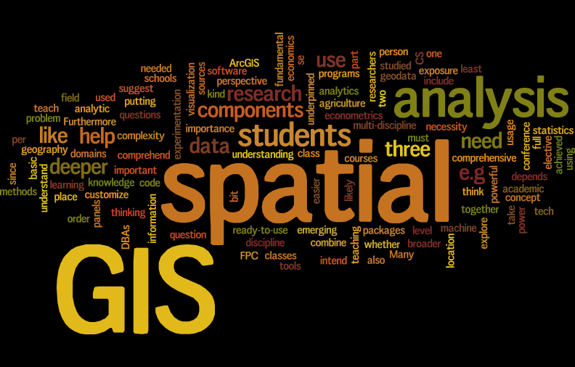
Broader and deeper use of GIS and spatial analysis

Slide 25
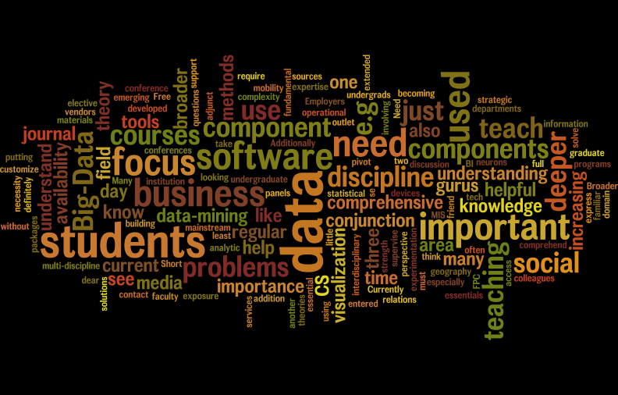
Broader and deeper use of GIS and spatial analysis: Without GIS, spatial, analysis, analytics, and research

Slide 26
Conclusions
This research is just a beginning to understand the current status of, and potential for, research in GIS and locational analytics by IS researchers.
Data analysis still preliminary, but some patterns seem to be emerging.
  Non-adoption: (of) Location Analytics & GIS in research much lower than expected.
  Importance of location in research questions: Considering location to be important in research questions in IS/MIS research areas bodes well for involvement with location analytics, spatial decision making, and GIS research.
  Theory: Knowledge of “spatial theories” appears to set advanced adopters apart.
  Role of graduate education: Offerings of coursework is inadequate, particularly for intermediate adopters’ institutions, which might be a reason for a limited use of location analytics and GIS in research.
  Role of journals: Both intermediate as well as advanced adopters perceive journals’ receptiveness to be low.
  Benefit of location analytics & GIS: Adopters sense spatial analysis to add beneficial insights in their areas of inquiry. Even about a half of non-adopters sense potential benefits (for research, scholarship, as well as students’ professional careers).
More data & research are required needed to better understand this area and solidify findings.
Notes:
Intermediate adopters: Adopters predominantly at an intermediate stage

Slide 27
Implications
Graduate education (spatial theories and analysis techniques) is critical for potential benefits to be realized.
Research outlets need to develop a focus in this area of research.
In addition to graduate education and research outlets, Inhibitors and enablers of research in this area needs to be identified by further research so that mechanisms can be developed to promote research in this area.
Potential or opportunities for research is considerable.
Notes:
Workshops, tutorials, panel discussion, availability of software, vendor involvement in conferences—for critical mass and incentives?

