Slide 1
Social Media, Crime Prediction,
GIS, and Enhanced NLP Text Analysis
Anthony Corso
Claremont Graduate University
Center for Information Systems and Technology

Slide 2
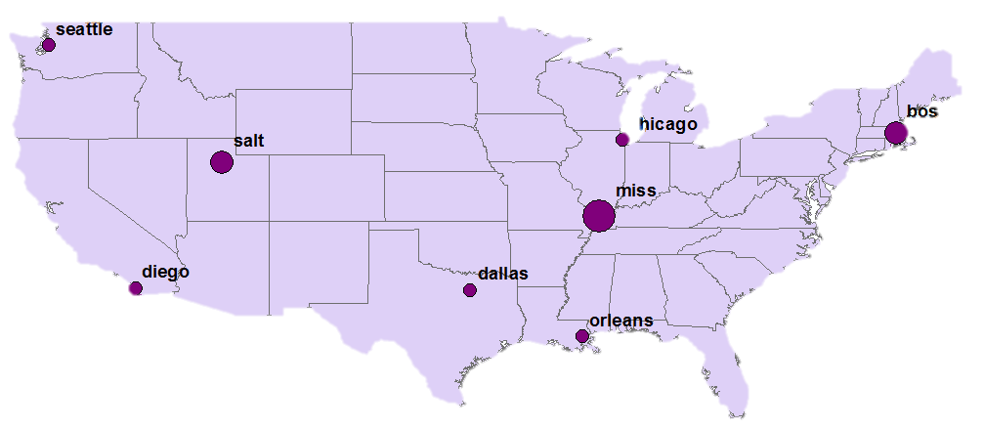

GIS Social Media Crime Prediction
Seattle
Boston
Salt Lake
Chicago
New Madrid
San Diego
Dallas
Number of Colleges
New Orleans

Slide 3
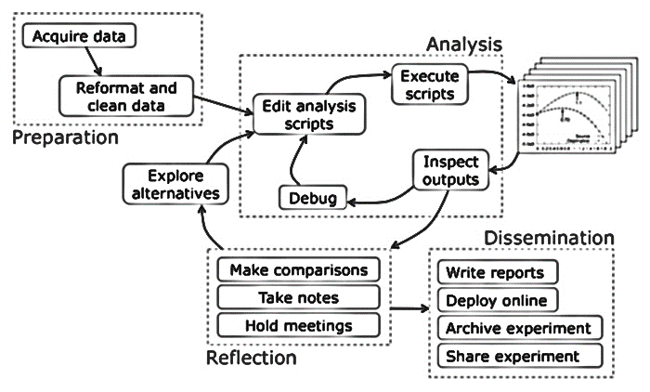
Data Science Workflow
Preparation
Analysis
Reflection
Dissemination
Notes:
http://cacm.acm.org/blogs/blog-cacm/169199-data-science-workflow-overview-and-challenges/fulltext

Slide 4
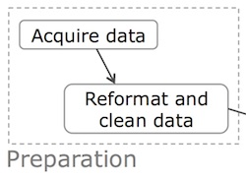
Data Science Workflow Preparation
Social Media Corpus
Crime Data
SNAP Data
ArcGIS Solution
Notes:
http://cacm.acm.org/blogs/blog-cacm/169199-data-science-workflow-overview-and-challenges/fulltext

Slide 5
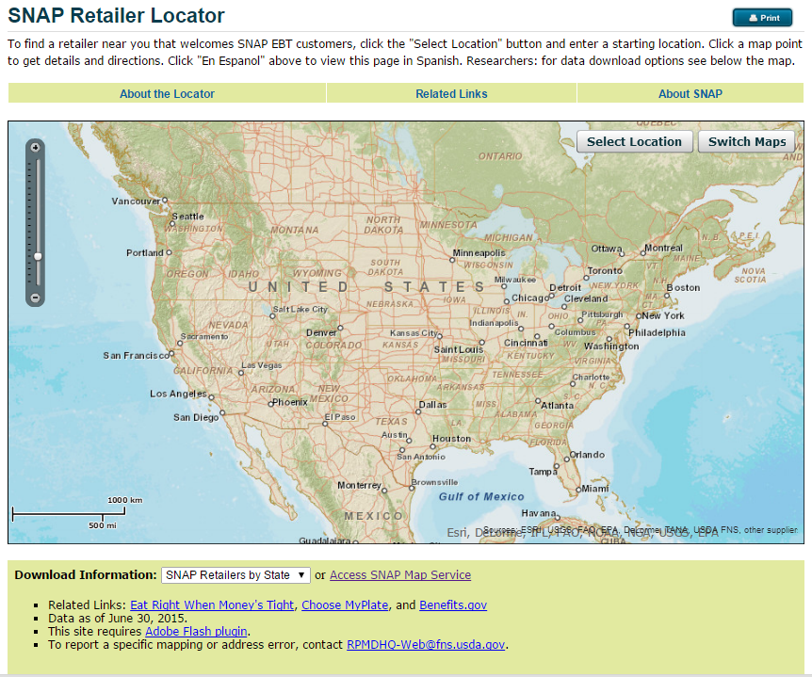
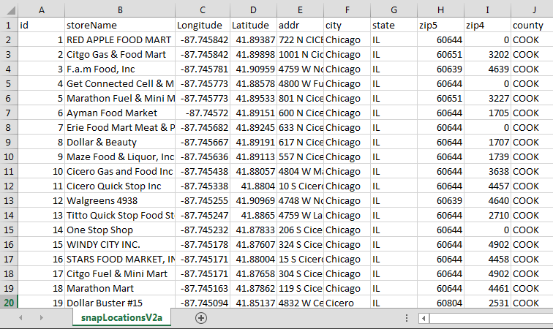
Acquire Data
SNAP Retailers
Notes:
http://www.fns.usda.gov/snap/retailerlocator

Slide 6
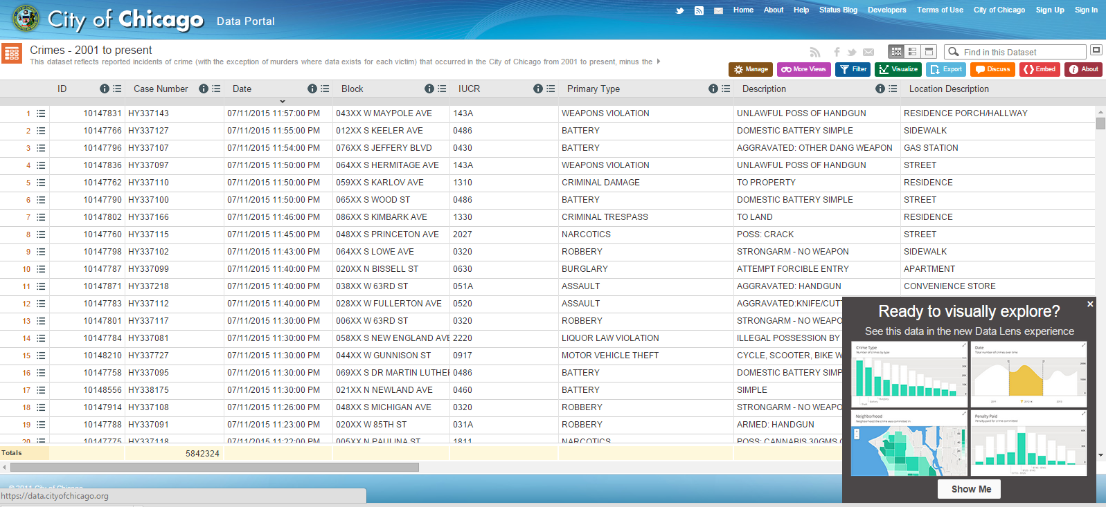
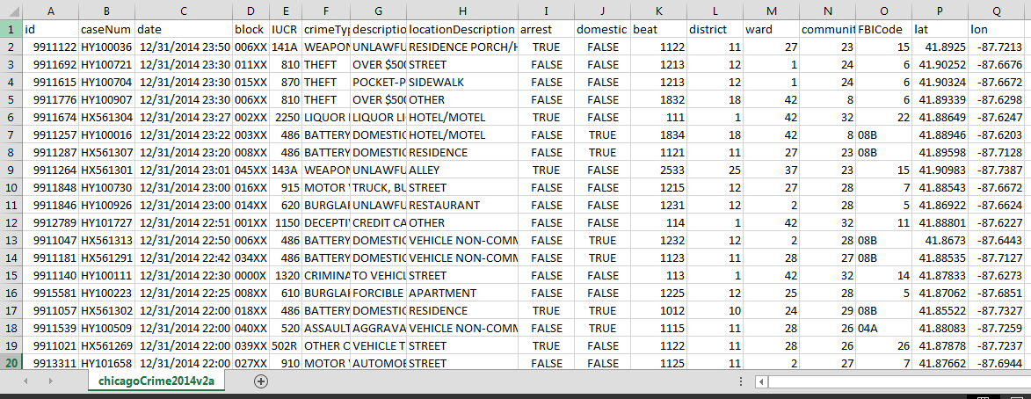
Acquire Data
City of Chicago Crime
Notes:
https://data.cityofchicago.org/Public-Safety/Crimes-2001-to-present/ijzp-q8t2

Slide 7


Acquire Data
Tweet Corpus
Social Media Data
Twitter API
Tweets
(8) Twitter Streams
~ (1) billion Tweets collected over (10) months – stored both locally and on AWS

Slide 8
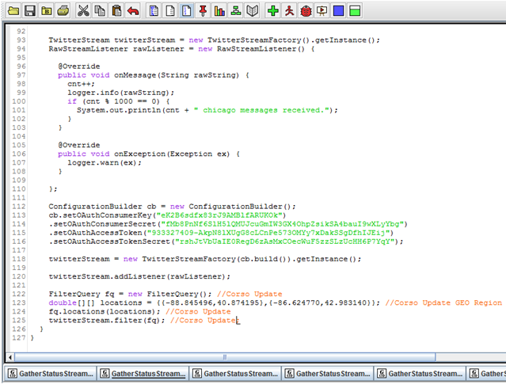
Acquire Data
Twitter Streaming Parameters
Twitter-Specific
API Information
Geographic Area /
Bounding Box

Slide 9
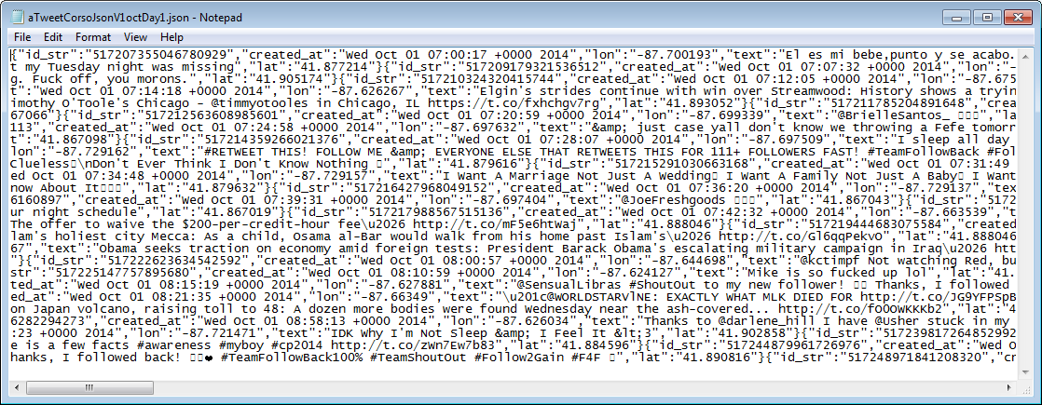
Clean Data
Tweet Preprocessing— Raw Data

Slide 10
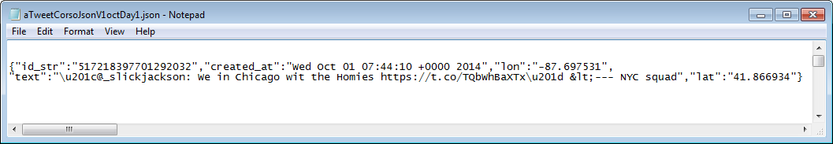
Clean Data
Tweet Preprocessing— Unit of Measure

Slide 11
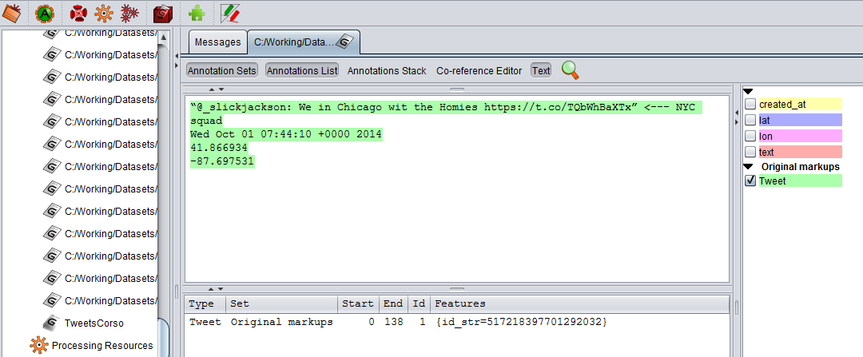
Clean Data
Tweet Preprocessing— Text Analysis with GATE

Slide 12
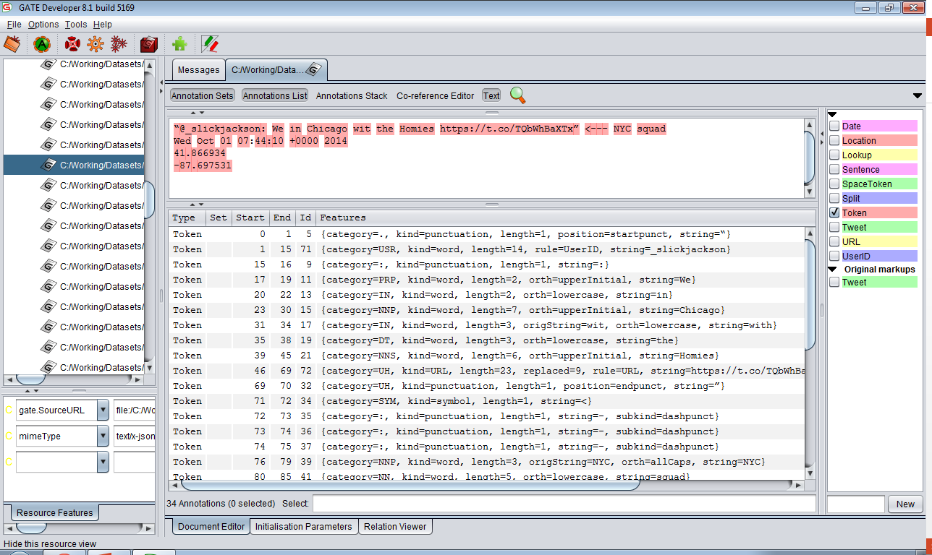
Clean Data
Additional NLP Text Analysis with NLP Enhancements

Slide 13
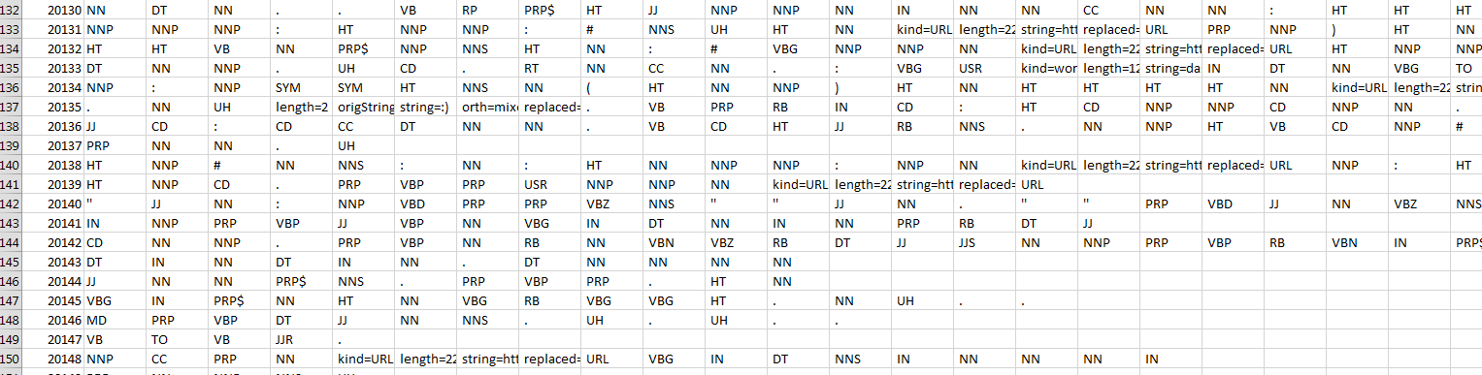
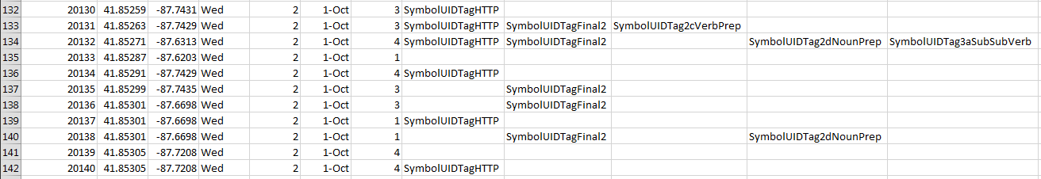
Clean Data
Resultant Output— NLP Geo-Tagged Tweets

Slide 14
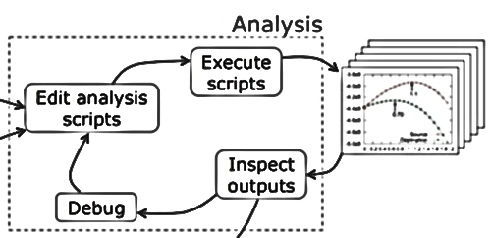
Data Science Workflow Analysis
Notes:
http://cacm.acm.org/blogs/blog-cacm/169199-data-science-workflow-overview-and-challenges/fulltext

Slide 15
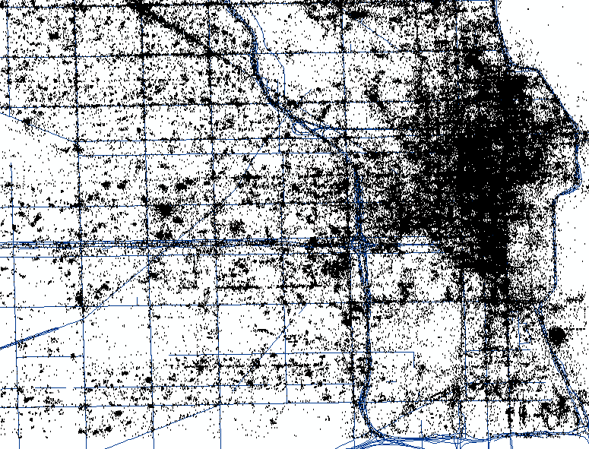
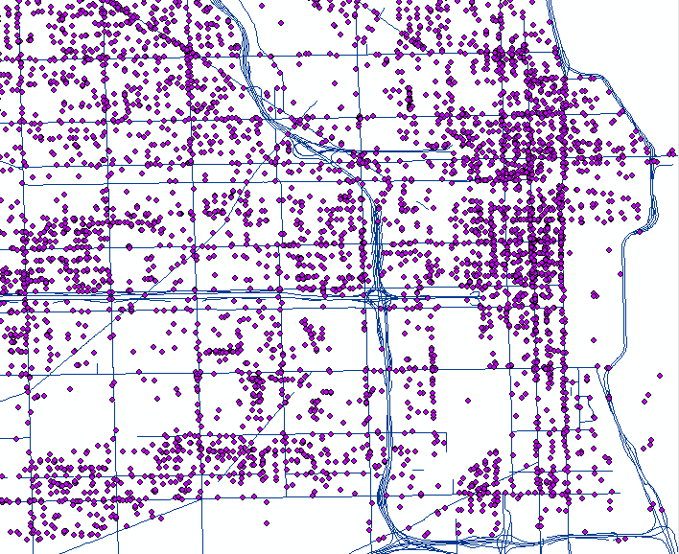
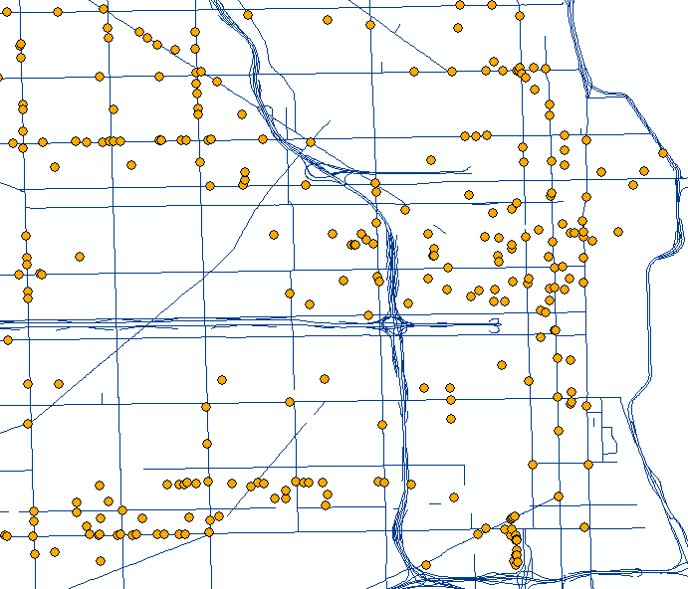
Analysis
GIS Data Layers
Tweets Crime SNAP Retailers

Slide 16
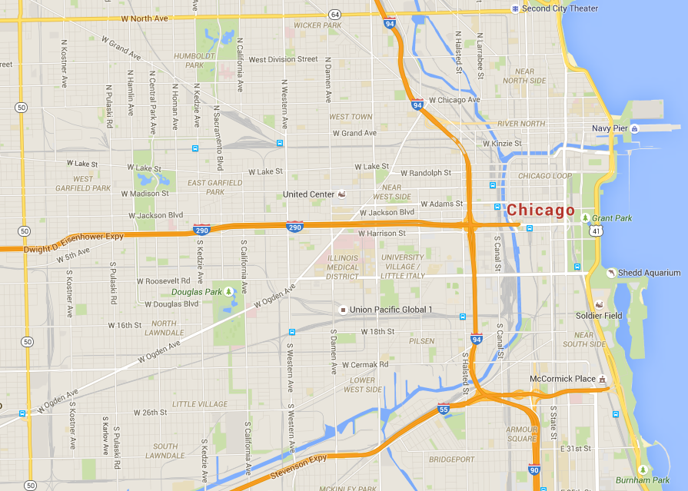
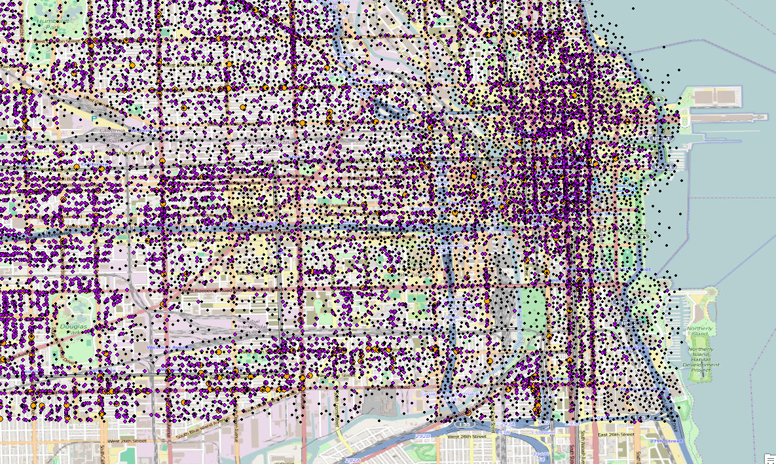
Analysis
Just Points!

Slide 17
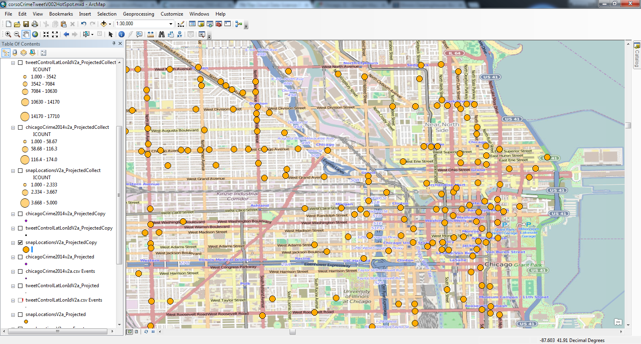
Analysis
NLP Geo-Tagged Tweets, Crime, and SNAP

Slide 18
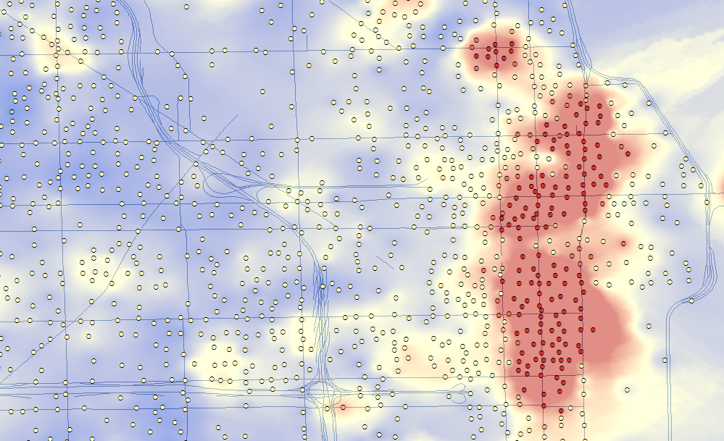
Analysis
Hot Spot Analysis - NLP Geo-Tagged Tweets, Crime, and SNAP

Slide 19
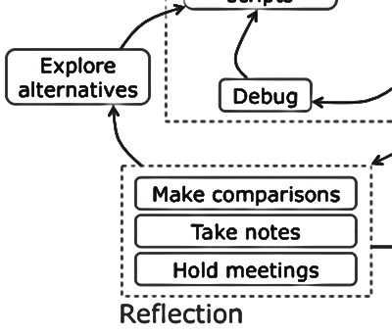
Data Science Workflow Reflection
Notes:
http://cacm.acm.org/blogs/blog-cacm/169199-data-science-workflow-overview-and-challenges/fulltext

Slide 20
Explore Alternatives
Iterate
Next Steps…
Findings…

Slide 21
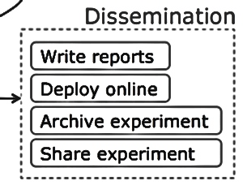
Data Science Workflow Dissemination
Notes:
http://cacm.acm.org/blogs/blog-cacm/169199-data-science-workflow-overview-and-challenges/fulltext

Slide 22
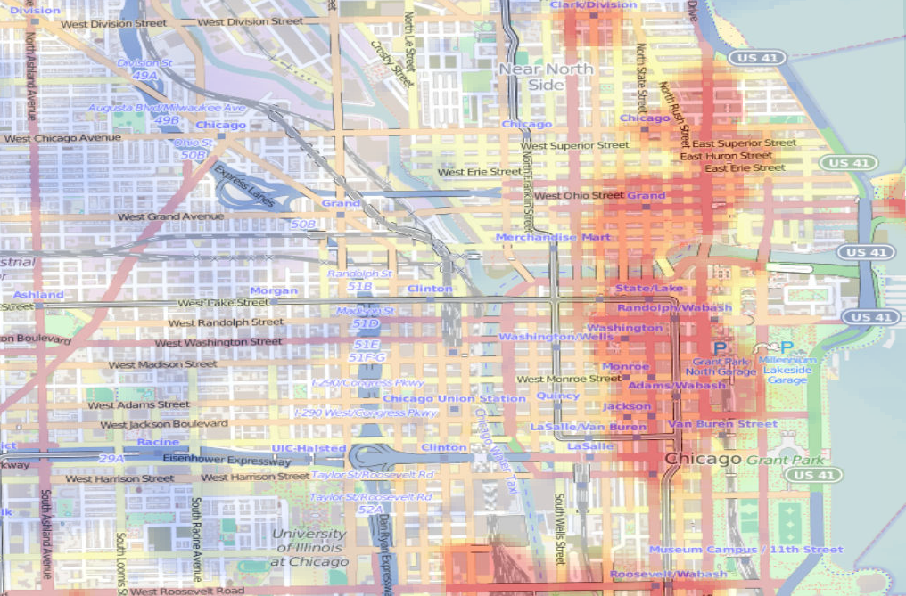
Questions

