Slide 1
Spatial decision making
Peter Keenan
University College Dublin
Pre-ICIS SIGGIS Workshop
Dublin, Ireland
December 11, 2016

Slide 2
Spatial decision making
Location is everything!
  What we can do is dependent on where we are!
Decision making requires
  Knowing where we are
  Knowing where we can go to
  Knowing where we want to go to
Many decisions have a spatial element, but are not entirely spatial.

Slide 3
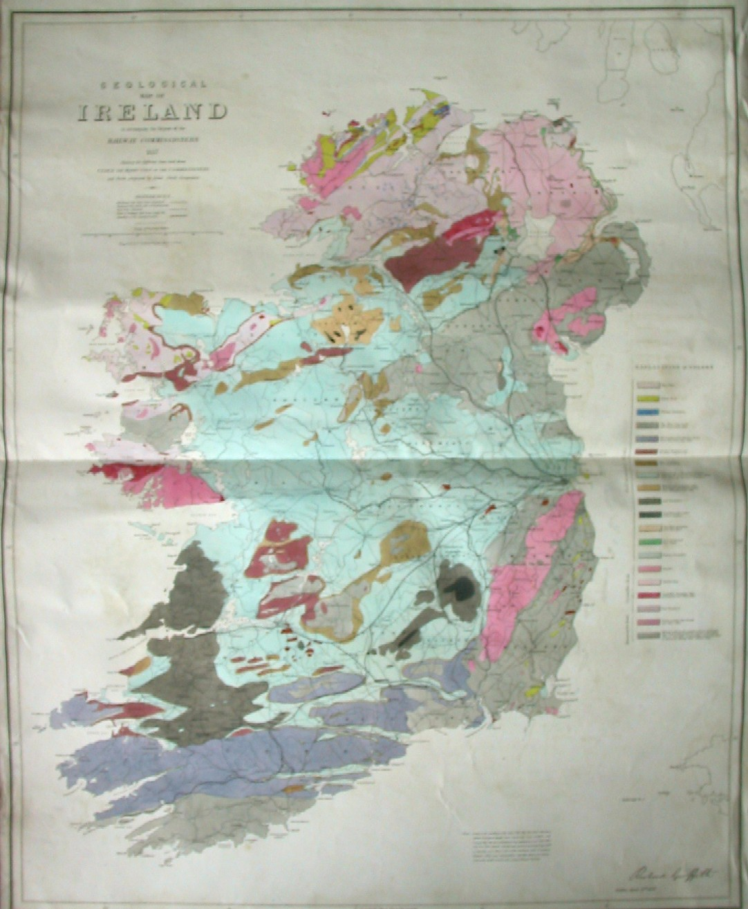
Irish Railway map 1838
‘Atlas to accompany the second report of the Irish Railway Commissioners’, displayed on the same map
  population
  traffic flow
  geology
  topography

Slide 4
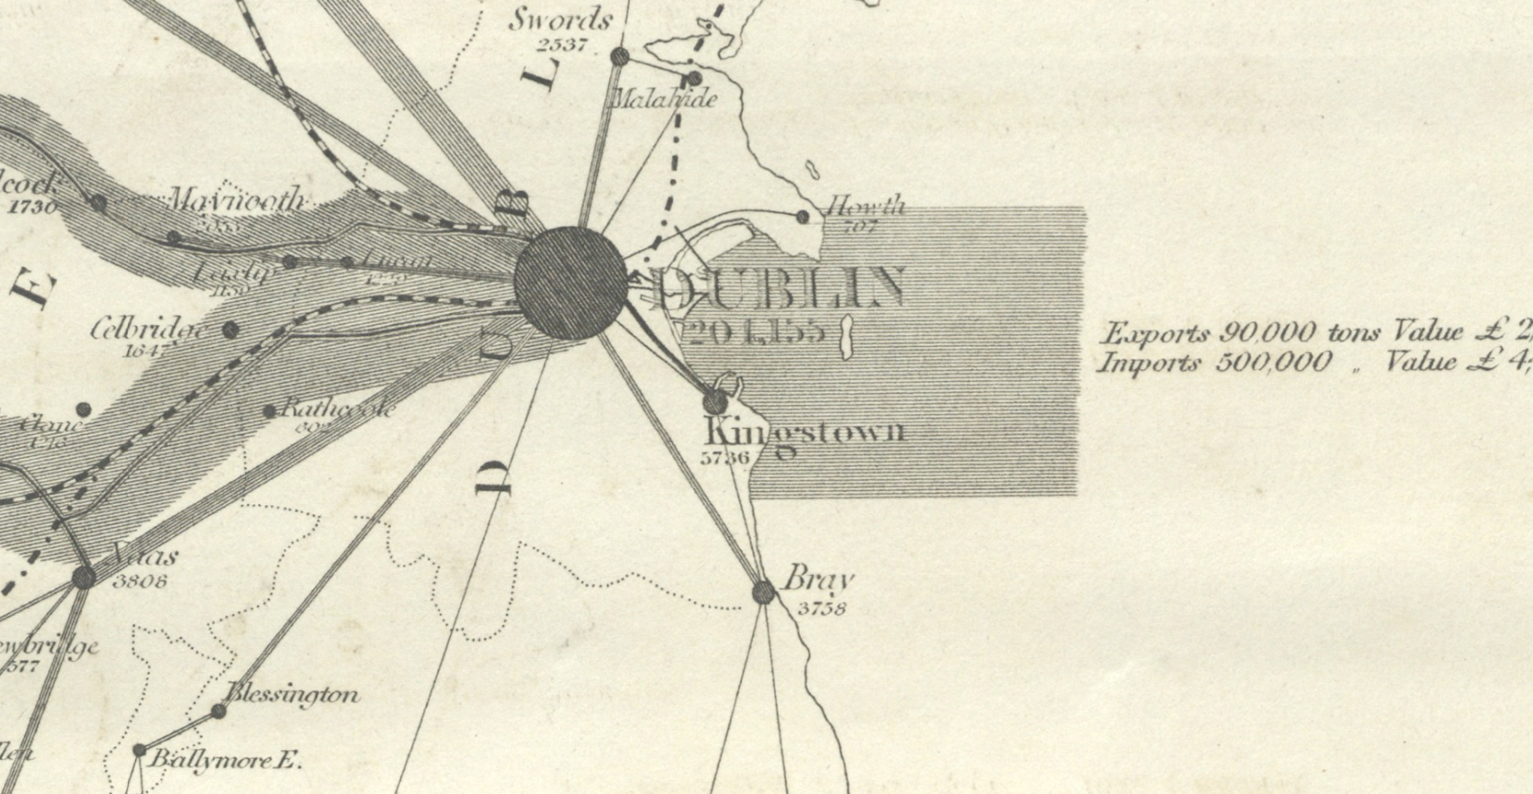
Traffic flow

Slide 5
Spatial Techniques
Spatial techniques identify trends not obvious from other forms of analysis
  e.g 1854 John Snow

Slide 6
Decision making
What is? Intelligence (Simon)
  GIS records data
  Geographic context, not decision context.
What do I want? Design (Simon)
  This is the decision maker
  Many different decisions
How do I choose? Choice (Simon)
  relevant information
  alternatives

Slide 7
Decision Support Systems
Decision making needs support from IT
Decision support requires specific customised applications, incorporating data, models and a user friendly interface.
Spatial DSS incorporates decision models with spatial models and data.
The challenge is to use data that may be used for many purposes for the needs of specific decision makers.

Slide 8
Same data – many decisions
specific
model
specific
model
specific
model
specific
model
specific
model
specific
model
SDSS
SDSS
SDSS
GIS software
Spatial Data
Infrastructure

Slide 9
DSS life cycle
IT applications typically start with cost saving and move to providing better information for decisions.
Spatial applications
Activity Technology
Recording Remote Sensing
Reporting/Query GIS
Analysis/Modelling SDSS

Slide 10
Evolution of SDSS
Evolution | Early DSS | Later DSS | Spatial DSS
Data | Transaction processing data | Data warehouse | Spatial data
Simple reporting | Structured reports Simple generic summarisation models | Data mining OLAP Dashboards | Computerised mapping Generic spatial models in GIS
Specific DSS | PC based DSS | Internet DSS | SDSS

Slide 11
SDSS areas of application
traditional GIS data processing users
who have moved to decision making.
  forestry
  public utility
areas where better spatial data improves model driven approaches
  routing
  location analysis
New areas where the availability of suitable data and powerful software provides new applications.
  marketing
  ecological modelling

Slide 12
Evolution of SDSS
Operations Research/
Transaction processing
Computer Cartography
Management Science
Optimization and
simulation models
Database management
Spatial analysis
Geographic
Decision Support Systems
Info. Systems
DSS
GIS
Group behaviour
Location
Spatial data management
Science
Group Support Systems
Publicly available
Spatial Decision Support
spatial databases
Systems

Slide 13
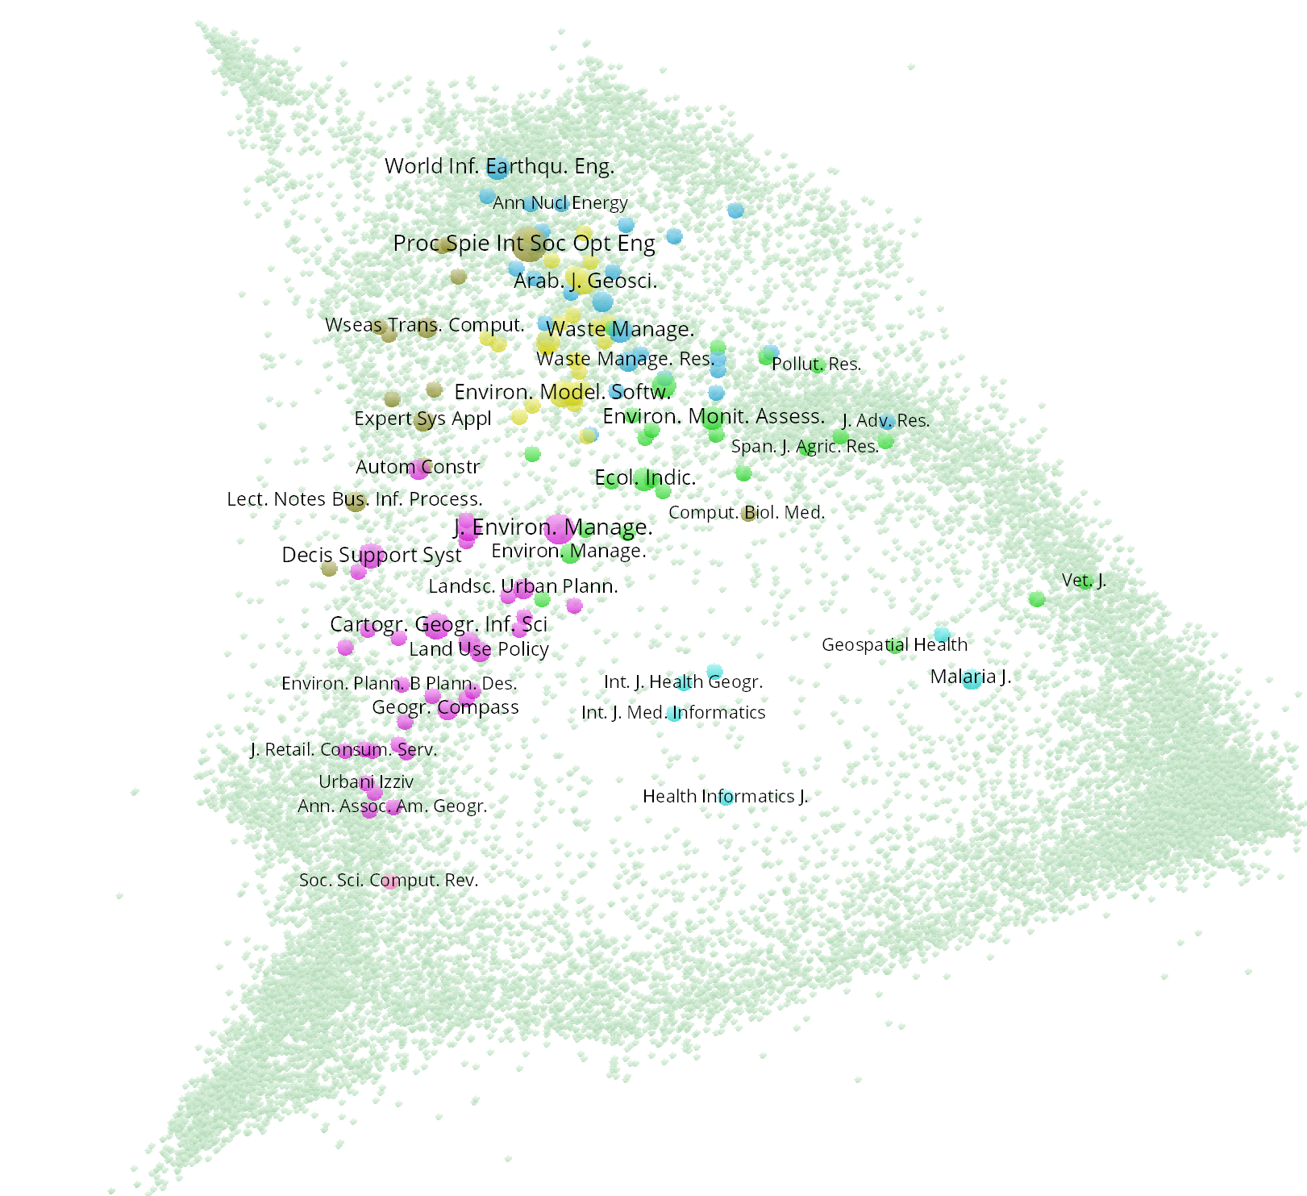
SDSS publications in Scopus
Traditional areas
  transportation
  planning
Newer examples
  Environmental management

Slide 14
SDSS contribution to decisions
Faster decisions
  Emergency response
Access to more data
  Spatial data infrastructure (SDI)
Assessment of more options
  Expanding cognitive capacity of decision makers
More complex modelling
  Optimisation
Incorporation of more decision makers
  Public participation GIS

Slide 15

Questions

